Slide 1
Becker Avionics Group
August 2017

Slide 2

Radio & Avionics Solutions Provider for 50+ Years
Max-Egon Becker founded Becker Flugfunkwerk GmbH in 1956

Slide 3
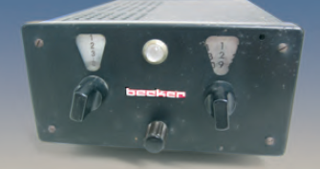
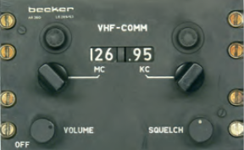
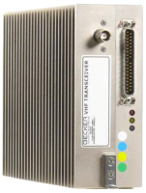
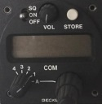
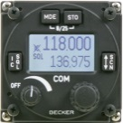
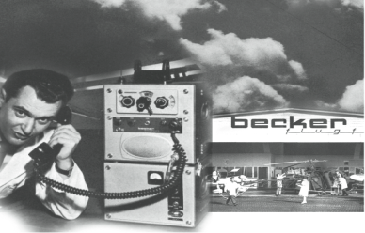

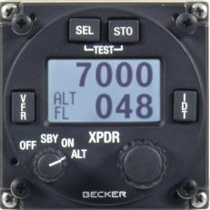
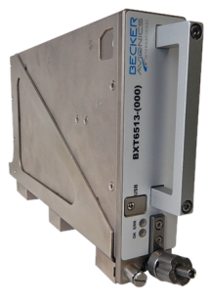
Becker Long Presence In Radio & Avionics
First fully transistor-ized airborne radio
VHF Transceiver for larger Aircraft
AR 3201 - Compact
VHF Transceiver
8,33 kHz VHF Transceiver
VHF Transceiver
RT6512 (20W)
1956
1961
1968
1973
1983
2005
2010
2016
Becker Flugfunkwerk
founded
XPDR – ATC2000
Mode A/C
XPDR – BXP64xx
Mode S
XPDR - BXT6513
Mode S incl. ADS-B
NAV
NR 2020
ADF
2050
First Ground Station
1957
Notes:
XPDR: ATC 3401: 1997, ATC4401: 2001
NAV: NR 200: 1966
Marker: MBR 1: 1969
COM: AR2011 / 25A:1981, AR 400: 1968, AR3201: 1983 & much more
ICS: AL3: 1960, MSU/SSU: 2004

Slide 4
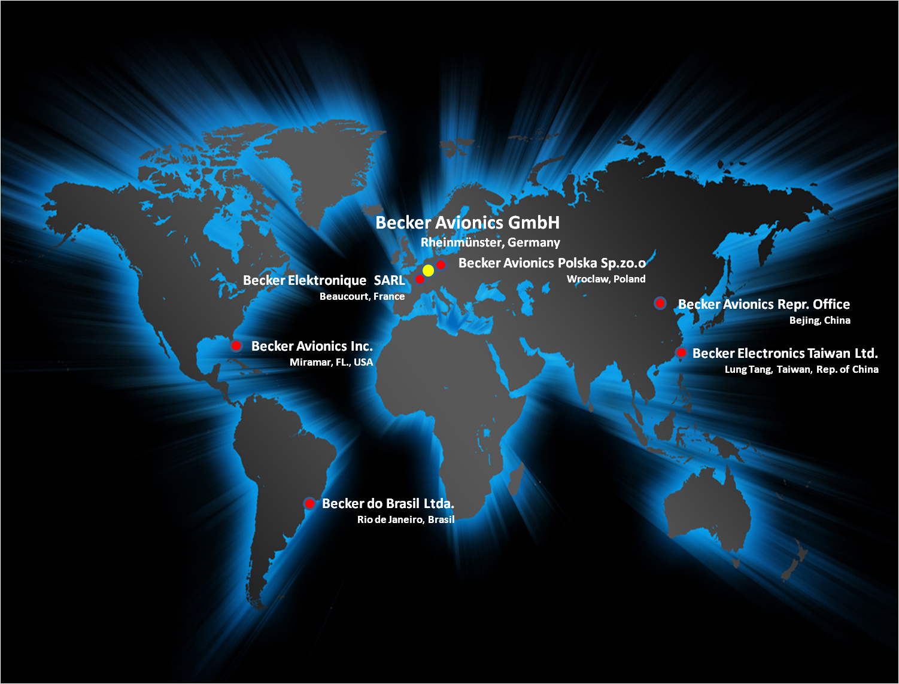
Becker Avionics Worldwide Operations
Medium sized company with international orientation

Slide 5
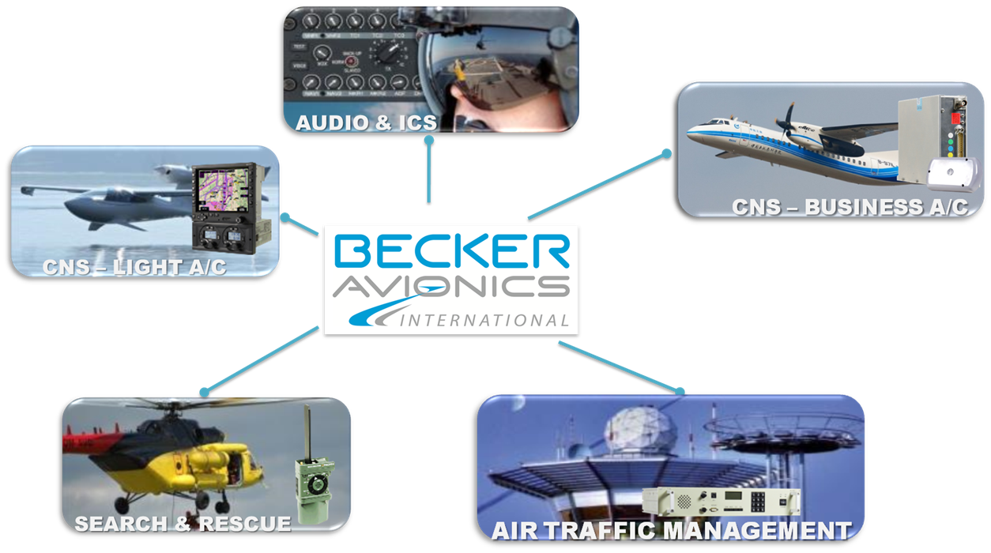
Becker Avionics Product Portfolio

Slide 6
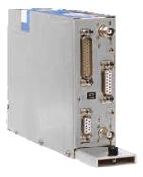
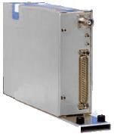
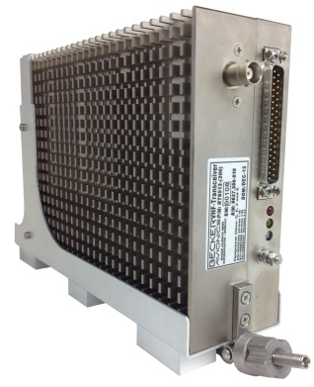
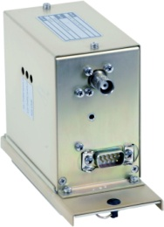
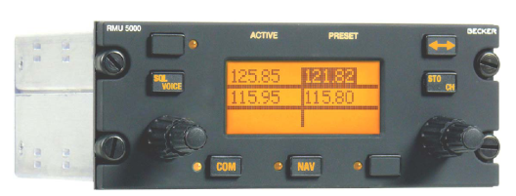
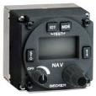
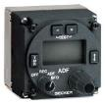
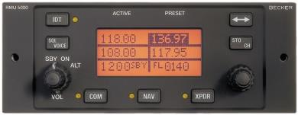
CNS Primeline Com Nav Products
Functions:
  COM (RT6512)
  NAV (RN3320)
  ADF (RA3502)
Compact and light-weight
Marker Receiver (analog)
ETSO certified:
No forced cooling required
Seperate remote and control units for flexible installation
Installation kits available
RT6512
MKR3300
RN3320
RA3502
RMU 5000 for DZUS or 160mm
Corresponding individual
Control Units (CU)

Slide 7

BXT Primeline Mode S/ ADS-B OUT Transponder Family
BXT6513
BXT6553
TCAS II Compatable
Design Assurance Level B
Common Hardware
13 - 47% Less Volume Compared To The TDR94D & MST67
Saves Up To 55% Of Weight
  2.2 Kg Less Than MST-67A Or 0.8 Kg Less Than NXT-700
Passive Cooling - No Fans / Air Holes
Operating Temp -55C <> +70C
Affordability
  Target Market Price Half Of Current Offerings
  Simplified Installation, Configuration & Updating ON WING
  Cost Of Ownership Less Due To Reliability, Extended Warranty Period
-(000)-()
Dual Antenna
Diversity
-(010)-()
Single Antenna
-(100)-()
Aircraft OEM Standard Fit

Slide 8

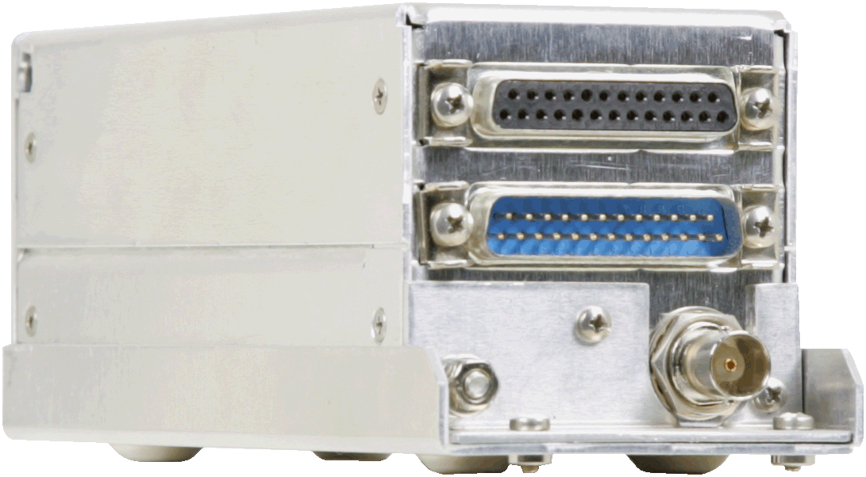
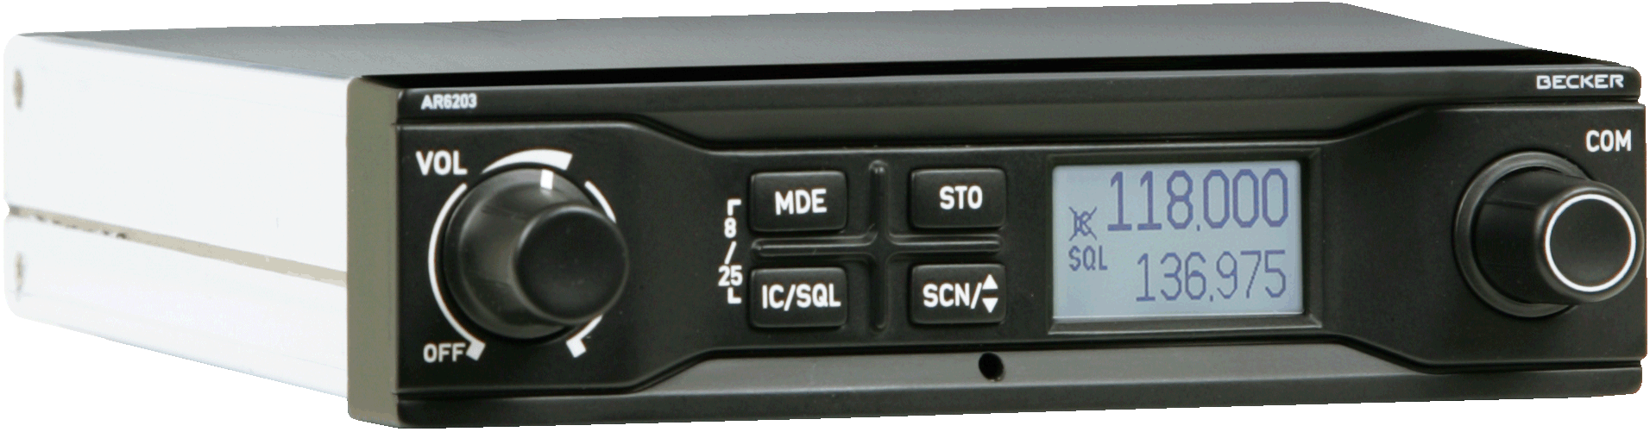
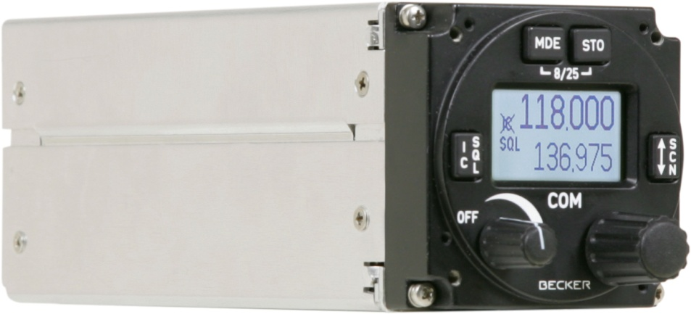
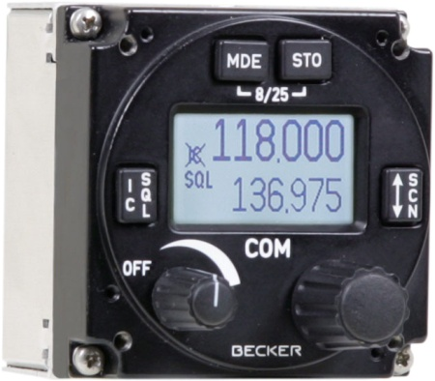
CNS Compact Line VHF COM
RT6201
AR6203
8.33kHz /25kHz
6 or 10 Watts
10-30V
Scan Modi
VOX IC
4 place Intercom
Tandem
Software Level D
AR6201
RCU6201

Slide 9

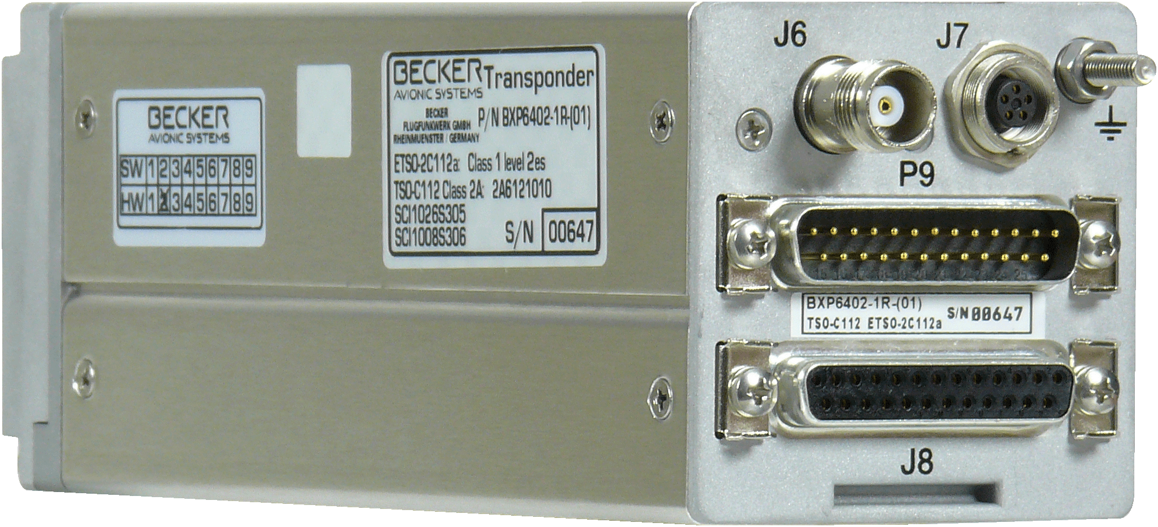
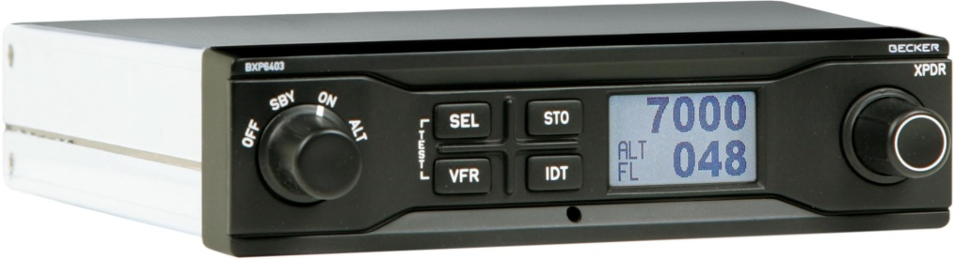
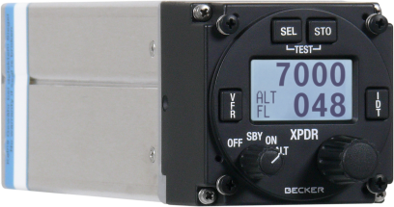
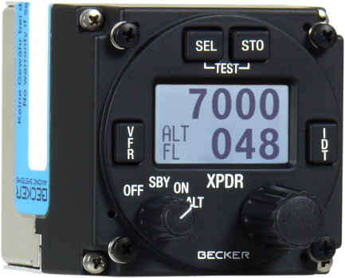
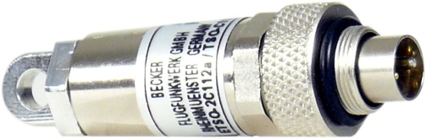
CNS Compact Line MODE S Transponders
BXP6402
BXP6403
Class 1 - 250 Watt
Class 2 -150 Watt
Address Module
Blind Encoder
ADS-B out
(not certified)
AMP - Programer Kit
BXP6401
CU6401
AM6400

Slide 10
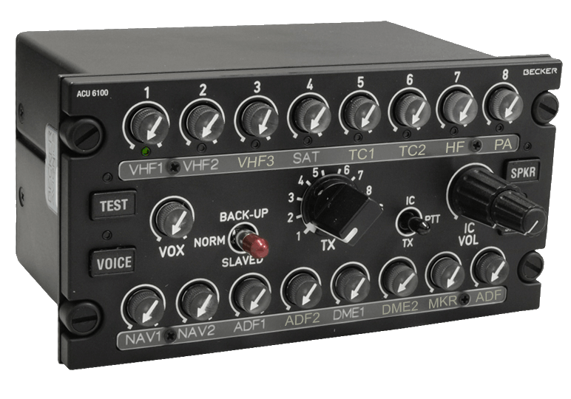
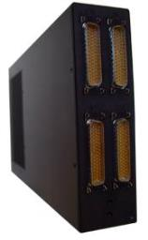
ICS Digital DVCS6100
Fully digital audio processing based on DSP technology
software configurable
proven HMI and functionality for sophisticated missions
up to 8: transceivers/ receivers/
warning-tones
up to 6: control units per REU
8 DZUS Height
TSO/ETSO certified
NVIS green B compliant
ITAR-free
ACU6100
REU6100
H/C: AS350, Bo105, EC135, EC145, MD900, Bell412, Bell429
S-70A, A/C: Do228, MA600, Pilatus PC-9, PC-12, L-410, KingAir 350, DHC-5 Buffalo, Dash-8, CN235, C-130 Hercules

Slide 11
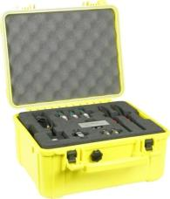
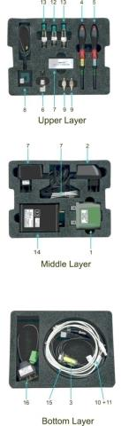
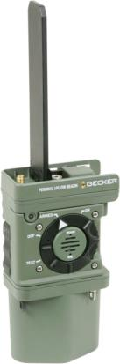
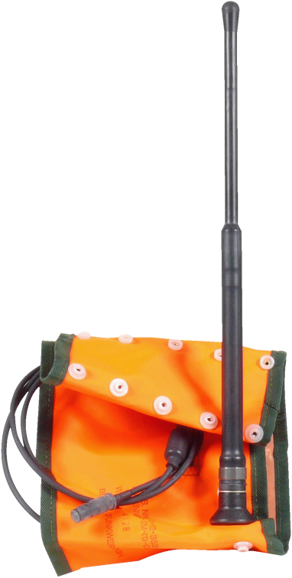
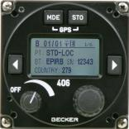
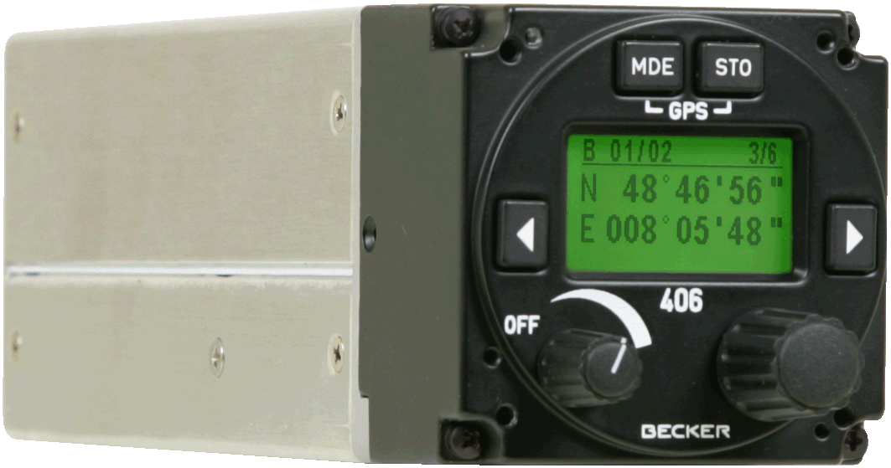
SAR PLB System 406Mhz Cospas-Sarsat
MR510 PLB (with Antenna SWA) BD406 Beacon Decoder Programming &
Test Set

Slide 12



ATM Systems VHF COM Ground Station
VHF multichannel receiver, transmitter and transceiver for ground
to air communication at airfields, airlines
and control centres
118-137 MHz frequency range
(118-156 MHz optional)
8.33 kHz channel spacing
Simple and easy to operate
Local and remote control operation
Digital signal processing
Built in test (BIT)
Power output rf: 20watt
Power output rf: 6 watt
TG560
TG660

Slide 13
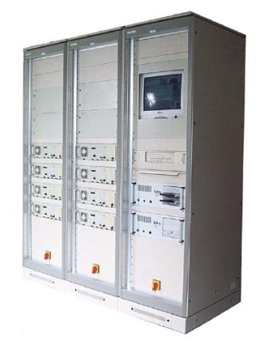
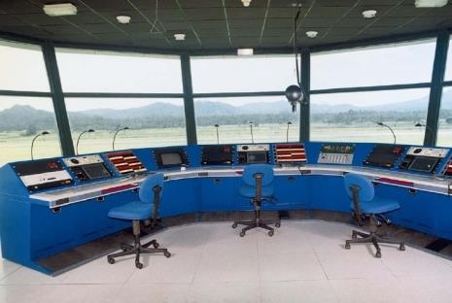
ATM Infrastructure
Tower control consoles and 19inch racks
Tower Karlsruhe Baden
Transmitter and Receiver 19 inch racks

Slide 14


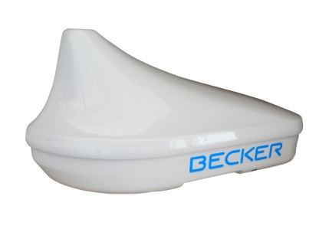
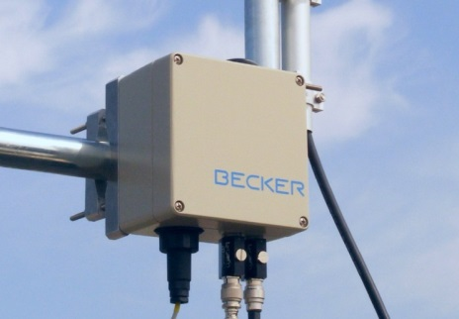
ADS-B OUT Solutions for Airport Ground Movement
application in the airport area can include:
  Situation awareness improvement,
  Ground traffic management,
  Runway incursion prevention,
  Vehicle operation coordination and optimization
BAR6216
BAV6215

Slide 15




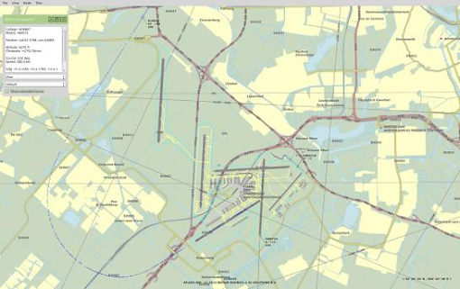
ATM Ground Traffic and Flight Following
Innovative flight tracking system
Basic situational awareness
Flight following for airlines and fleet operators
3 different all-in-one solution packages
focused on your operational requirements, scalable on demand with optional features
flight tracking and
fleet following
aerodrome air traffic situational awareness
airport ground
traffic control

Slide 16
Select Becker Avionics Customers
Bundeswehr
French Gendarmerie
German Air Force
German Marine
German Police
Hindustan Aeronautics Limited (HAL)
Indian Navy and Coast Guard
Indonesian Aerospace (IAe)
Korea Aerospace Industries (KAI)
NATO Helicopter Industries (NHI)
Royal New Zealand Air Force
South African Air Force
US Navy
Airbus
Airbus Helicopters
ATR
BELL Helicopter
Diamond Aircraft
GARMIN
Grob
Helibras
Lufthansa Systems
Pilatus
Piper
RUAG Aerospace
Tecnam
Xian Aircraft

Slide 17




















Select Becker Avionics Partners

Slide 18

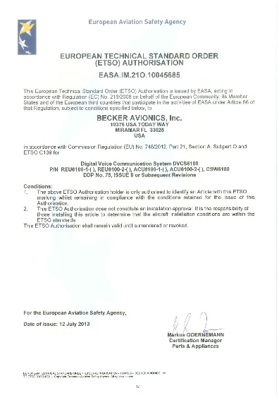




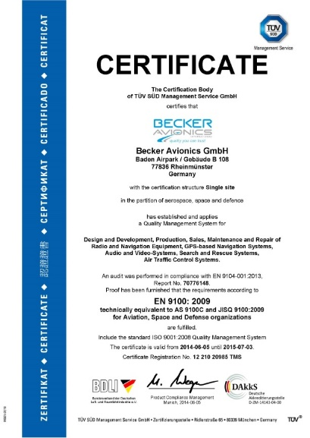

Becker Avionics Certifications & Qualifications
Becker Germany:
  EASA Part 21: DE.21G.0075 issued by LBA
  EASA Part 145: DE.145.0166 issued by LBA
  ISO 9001:2008: 12 100 20985 issued by TÜV SÜD
  EN 9100:2009 : 12 100 20985 issued by TÜV SÜD
  BWB: BWB-1921Y-B07/13/01: issued by BAAINBw
  DO/PO agreements with Airbus, Airbus Helicopters, RUAG,
  Xian Aircraft Company, Aerotechnik
Becker USA
  ISO 9001:2008: C2014-01024 issued by
  Perry Johnson Registrars
  FAR Part 145: B6NR431N issued by FAA
  FAR Part 21
Becker Poland
  ISO 9001:2008: 912051395/2 issued by DEKRA
Becker France
  ISO 9001; ISO 13485, IPC Member

Slide 19
EASA AP-DOA Design Approval Case
ETSO | Scope
C139 | Audio Selector Panels and Amplifiers
C74 | Airborne ATC Transponder Equipment
C88 | Automatic Pressure Altitude Reporting Code Generation Equipment
C112 | Air Traffic Control Radar Beacon System / Mode Select Airborne Equipment
C113 | Airborne Multipurpose Electronic Displays
C166 | Extended Squitter Automatic Dependent Surveillance-Broadcast (ADS-B) and Traffic Information Services (TIS-B) Equipment 1090MHz
C195 | Avionics Supporting Automatic Dependent Surveillance-Broadcast Aircraft Surveillance
2C34 | ILS Glide Slope Receiving Equipment 108-112 MHz
2C35 | Radio Marker Receiving Equipment
2C36 | Airborne ILS Localizer Receiving Equipment 108-112 MHz
2C40 | VOR Receiving Equipment 108-117,95MHz
2C41 | Airborne Automatic Direction Finding (ADF)
2C66 | Distance Measuring Equipment (DME) 960-1215 MHz
2C91 | Emergency Locator Transmitter (ELT) Equipment
2C169 | VHF Radio Communication Transmitting Equipment 117,975-137 MHz

Slide 20

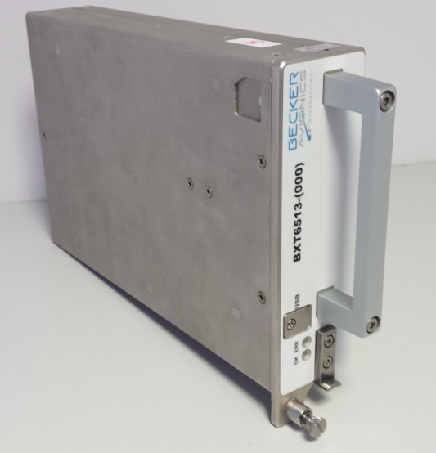
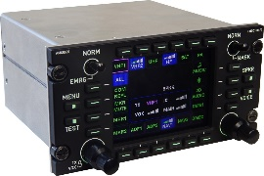
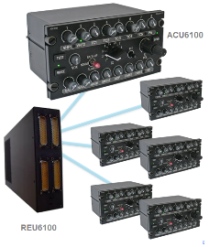

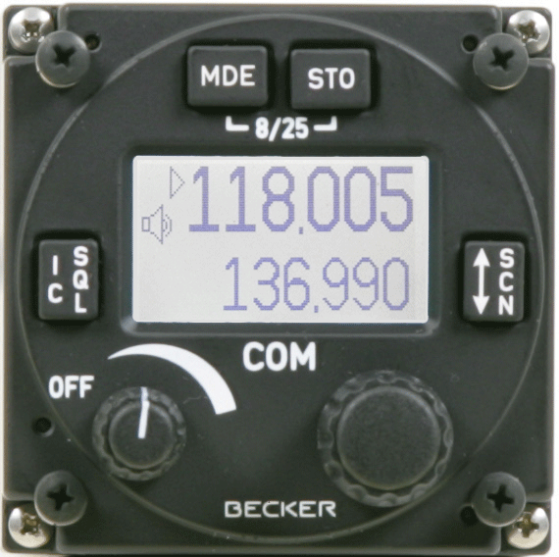
Becker Avionics Organization
R&D Capabilities
Organization and Skills
Technologies
Tools and Processes
Intellectual Properties
Production Capabilities
Organization and Skills
Technologies
Tools and Processes
Maintenance Capabilities
Maintenance Organization

Slide 21

R&D Organization & Full Time Employee Staff
QA / Airworthiness
R&D
R&D
SAR
CNS
ATM
ICS
Documentation
33 FTE
1 FTE
14 FTE
Product Line Mgmt
ICS Intercommunication Systems
SAR Search and Rescue
CNS Communication Navigation Surveillance
ATM Air Traffic Management
6 FTE
EASA / Customer
5 FTE
1 FTE

Slide 22
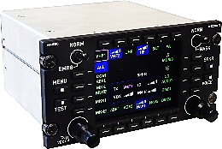
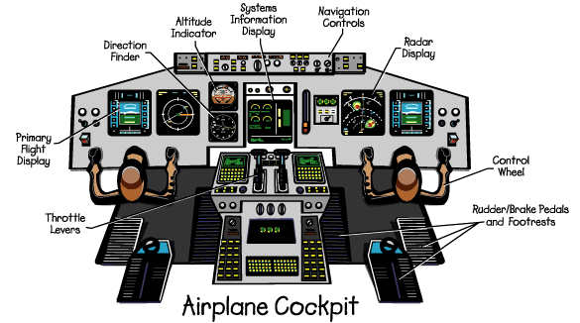
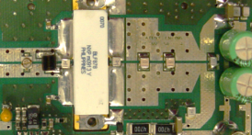


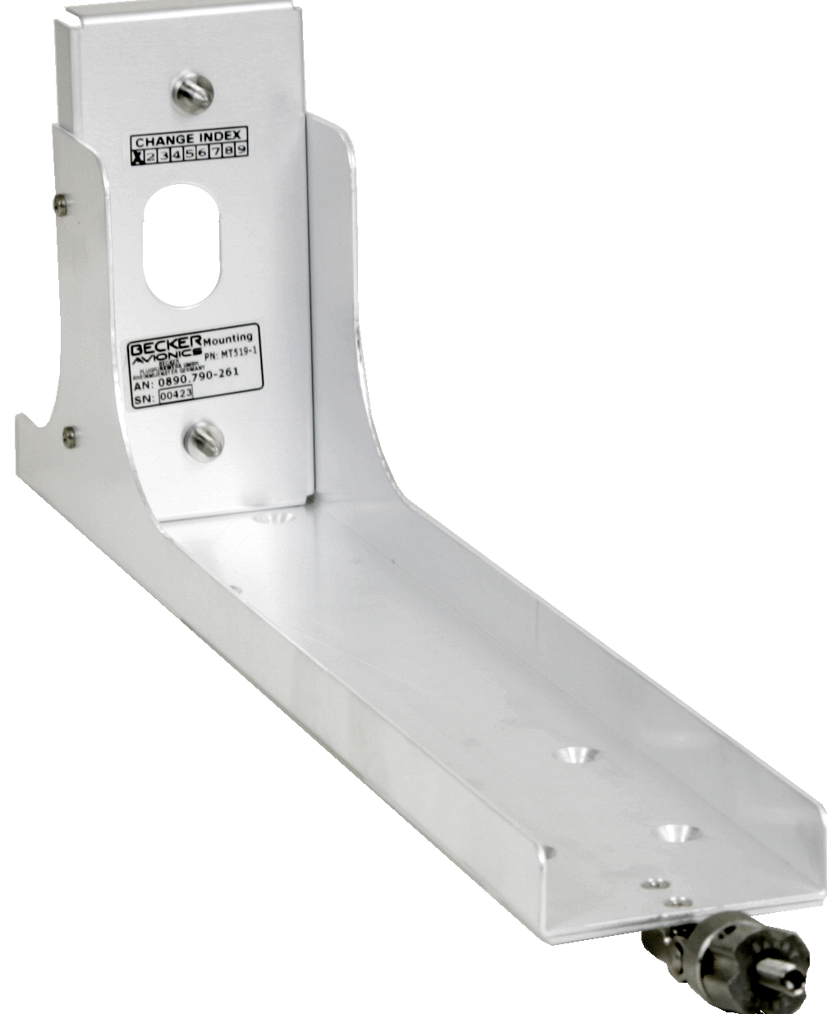



Technologies & Expertise
Technologies & Expertise
HMI / Panels
RF
Embedded Software
DO-178
Mechanical Design
Digital Hardware
Env. Qualification
DO-160
Configuration Software
DO-178
Analog Hardware
DO-254
System Engineering

Slide 23
R&D Intellectual Properties
Veröffentlichungs-Nummer | Offenlegung | Art | Titel
DE000010120370A1 | 07.11.2002 | Patent | [DE] Verfahren und Anordnung zur Zustellung von luftfahrtrelevanten Daten an Datenbanken [EN] Method for feeding aeronautical data to data bank of aircraft navigational equipment, involves passing data ...
EP000001313048A3 | 21.05.2003 | EP | [DE] Verfahren und Anordnung zur Zustellung von luftfahrtrelevanten Daten an Datenbanken [EN] Method and device for delivering aviation relevant data to databases [FR] Méthode et dispositif pour la délivrance ...
DE202010006707U1 | 04.11.2010 | Gebrauchsmuster | [DE] Bedieneinrichtung
CN000102971970A | 27.04.2011 | Patent | [EN] Communications system for an aircraft
CA000002798107A1 | 10.11.2011 | Patent | [EN] COMMUNICATIONS SYSTEM FOR AN AIRCRAFT [FR] SYSTEME DE COMMUNICATION POUR AERONEF
DE102010019394A1 | 10.11.2011 | Patent | [DE] Kommunikationssystem für eine Luftfahrzeug
US020110277582A1 | 17.11.2011 | US Patent | [EN] Control panel
KR102013056234A | 02.11.2012 | KR Patent | [EN] COMMUNICATIONS SYSTEM FOR AN AIRCRAFT
US020130095763A1 | 26.12.2012 | US Patent | [EN] COMMUNICATIONS SYSTEM FOR AN AIRCRAFT
DE102011112124A1 | 07.03.2013 | Patent | [DE] Durchführvorrichtung [EN] Device for operating thickened portion having activation line for activating emergency radio, has passage orifice that is opened into first and second opening portions ...
EP000002567471A1 | 13.03.2013 | EP | [DE] KOMMUNIKATIONSSYSTEM FÜR EIN LUFTFAHRZEUG [EN] COMMUNICATION SYSTEM FOR AN AIRCRAFT [FR] SYSTÈME DE COMMUNICATION POUR UN AÉRONEF
DE102012013932A1 | 16.01.2014 | Patent | [DE] Empfangsgerät für ein Luftfahrzeug [EN] Receiving device for aircraft for receiving of electromagnetic signals, has radio compass for targeting electromagnetic radio signals emitting radio beacons, ...

Slide 24



Production Value Stream
Order Processing
PP (IFAX) Procurement
Integration
PCB Assembly
Calibration
Test
Delivery
Production Planing
Procurement
Commissioning
PCB Assembly
Soldering
Mechanical &
Electronics
RF
Audio
Display
Temperature
Vibration
Functional
Env.Stress
Packaging &
Shipping
91 types of sub-assemblies produced [2015]
120 types of devices produced [2015]
~ 500 different products / variants active
BAG
Batch Size: 1-400
ERP Sys: IFAX
Traceability of Devices and Subassemblies

Slide 25

PCB Manufacturing
  SMD Pick & Place:
    1 MY100
    1 MYDATA MY12
    1 MYDATA TP9-2
  Silkscreening :
    MY500
    ESSEMTEC SP200V vision
  Reflow :
    THERMATECH Z500C
    EXCELSIUS XRC8

Slide 26






Quality
Certified ISO 9001:2008
Certified ISO 13485 : 2012
Production according to IPC 610 classe 3
Stocking of components according JEDEC J-STD -033C

Slide 27


Prototype Manufacturing
BAP Production capabilities:
models assembly
prototyping
small series production of non-certified products

Slide 28



Integration & Test
Becker Electronics has also an air-conditioned assembly hall to ensure the repeatability of the processes and an area dedicated to assembling and testing of finished products to expand the range of services offered
Development of Test Equipment
Automation of
Programming
Configuration
Calibration
Functional Test
Environmental Test
Env. Stress Screening
Documentation & Traceability
Benefits
Repeatability
Scalebility (also by transfer to other locations)
Efficiency

Slide 29






Test

Slide 30
Maintenance & Repair Organization
 | Civil M & R | MIL M & R | Civil M & R
Certification | EASA Part 145: DE.145.0166 issued by LBA | BWB: BWB-1921Y-B07/13/01: issued by BAAINBw | FAA Part 145: B6NR431N issued by FAA
Other |  | Contracted Bundeseigenes Lager
# Repairs / a [2015] | ~1000 | ~120 w/o WTG
# Maintenance / a [2015] |  | 1193

Slide 31

Becker Avionics International
Becker Avionics International Headquarter:
Becker Avionics GmbH
Baden-Airpark B108
77836 Rheinmuenster, Germany
Contact: info@becker-avionics.com
www.becker-avionics.com
Becker Avionics International USA:
Becker Avionics, Inc.
10376 USA Today Way
Miramar, FL 33025,
Contact: info@beckerusa.com
www.beckerusa.com

Slide 32
Background Detail

Slide 33
Becker Avionics Group Structure
~200 employees
SWITZERLAND
Becker Avionics SA
(BASA)
BRAZIL
Becker do Brazil
(BdB)
Sales
GERMANY
Becker Avionics
GmbH (BAG)
HQ, QA, DEV, ICS,
PROD, Sales
POLAND
Becker Avionics
Polska (BAP)
DEV CNS & ATC
TAIWAN
Becker Electronics
Taiwan Ltd (BETL)
PROD HW
FRANCE
Becker Electronique SARL
(BEL)
EMS Production
UNITED STATES
Becker Avionics Inc.
( BAI )
PROD ICS, CNS, ATC, Sales
CHINA
Becker China
Sales

Slide 34
R&D Organization and Skills
Development department in Rheinmünster / Germany
14 employees
Responsibilities:
  Maintenance of the existing product portfolio (all products)
  New Product Development for AUDIO and SEARCH&RESCUE
  Airworthiness Office
Skill | #
Avionics (Master) | 1
Computer Science (Master) | 3
Electrical Eng. (Master) | 6
Mechatronics (Bachelor) | 1
Technician (vocational) | 2
Signal Processing (PhD) | 1

Slide 35
R&D Organization and Skills
Development department in Wrozlaw / Poland
33 employees
Responsibilities:
  Maintenance of the existing product portfolio for VHF communication, L-Band transponder
  New Product Development for ADSB-Transponder, Communication, Navigation, Air Traffic Management
Skill | #
Computer Science (Master) | 14
Computer Science (PhD) | 1
Signal Processing (PhD) | 1
Electrical Eng. (Master) | 13
Mechanics (Master) | 2
Technician (Dipl.) | 2

Slide 36
Technologies & Expertise
System Engineering
  Requirements Engineering: Requirements based design, test and validation
  Understanding of mission specific CONOPS (=Concepts of Operations)
  Product Architecture & Enabling Systems
  STTE
  Reliability Engineering & MTBF prediction acc. MIL HDBK 217f / 217plus
  Model Driven Design: Matlab / Simulink
Hardware Engineering
  Analog / Digital Audio Hardware
  Power Supplies
  Backup-Circuitry
  Bus-Systems / Interfaces: CAN, Ethernet, ARINC 429, MIL 1533, Bluetooth,
  RS422/485, Optical Link

Slide 37
Technologies & Expertise
Digital Hardware / Complex Hardware DO-254 (up to DAL B)
  Xilinx, Altera, VHDL
  FPGA, PLD
RF Engineering
  MF-UHF (~300kHz – 1,5GHz)
  Transmitter output power 0.1W up to 500Watt peak power
  Modulation Schemes: AM, FM, DPSK, Pulse,…
  Antenna design: for example 3 band VHF/UHF antenna
  Simulation
HMI
  Keypads, Rotary Encoders, Displays, Switches, NVIS, Human Factors ..
Environmental Qualification DO-160 and MIL-Standards
  In-house activities: temperature, humidity, vibration, ESD, power input, cond. susceptibility
  External: for example HIRF, Sand and Dust, Fungus, Magnetic, indirect lightning and other

Slide 38
Technologies & Expertise
Mechanical Design
  Housings, Mountings: 160mm, DZUS, ARINC 600, 2,5”, 3,25”, Custom
  Panels (also NVIS compatible)
  Creation & Maintaining Part Lists, Build Standards
  Rapid Prototyping with additive Manufacturing technology (w. external supplier)
  Design of aluminum injection molding components
  Design of plastic injection molding components
Project Management
  V-Model + some agile elements

Slide 39
Technologies & Expertise
Embedded Realtime Software DO-178 (up to DAL B)
  µP: TI OMAP, ARM9, PIC, Fujitsu MB90F54, HCS08, 8-32 bit
  DSP 16/32 bit, TI 5xxx, 6xxx, OMAP
  Language C
Digital Signal Processing
  Algorithms: Mixing, Scaling, AGC, NR, 3D Audio and more
Configuration Software
  Windows, C++, C#, Delphi
Test Automation
  Windows, C++, C#, Labview

Slide 40


















Development Tools
Mechanical Engineering
  PTC Creo
  Windchill
Software Engineering
  MS Visual Studio
  Code Composer Studio
  IBM Rational RT
  Vector Cast (in evaluation)
Hardware Engineering
  OrCAD
  Xilinx, Altera FPGA Tool-Chains
  Model Sim
  Pspice, LTspice,WinSmith, Eagleware
Config Management
  Source Gear Vault
Issue Tracking
  Bugzilla
Simulation / System Engineering
  Matlab / Simulink
  Polarion
Document Management / Archive
  DokuManager (Becker Development)
Part Lists, Industrialization
  IFAX (ERP)
Project Planning
  MS Project
Test Automation
  LabView
Obsolescence Mgmt
  Silicon Expert BOM Manager

Slide 41

Development Process
DO-178 DO-254 DO-160
PR
PDR
B-Mod
CDR
FAI
QR
SOP
A-, B-, C-Model
Need
Product
MRS
SYRD, PHAC, PSAC, ICD
HRS, SRS
HDD, SDD
MDD, EDD
ATR, ATP, QTR, QTP,
DDP
SWAS, HAS
TP, TR, SWCI, HWCI, MCI
SWVD, HWVD
Support
Processes
Proj.M
Config.M
Change.M
Dev.Stds

Slide 42
Development Program Typologie
Self-Funded
  Becker Products
Customer Funded
  NH90, CH53
Development for other companies
  Axness Wireless Intercom
  ComSoft ADS-B Receiver
Studies
  SESAR, LuFo
Participation in Working Groups
  EuroCAE: WG-49 (Mode-S), WG-51 (ADSB)
  RTCA DO-214
Outsourcing
  Make-Team-Buy
  Certification (ETSI) / Qualification

Slide 43




Production Organization and Skills
USA
Integration
Test
(Audio)
Germany
Integration
Test
Supply Chain
29 FTE
France
PCB Assembly
PCB Test
25 FTE
Poland
Prototypes
4 FTE

