Slide 1
Becker Avionics Group AviaSynthesys© OEM Solutions
Collaborative, Competitive & Value-Added

Slide 2
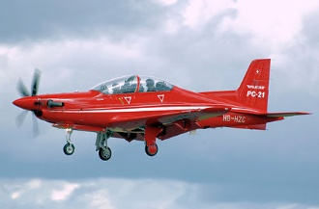
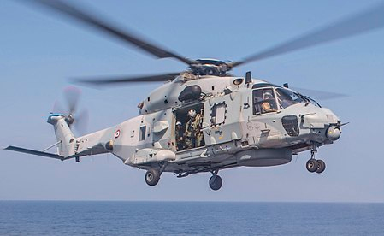
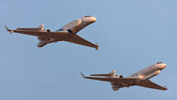
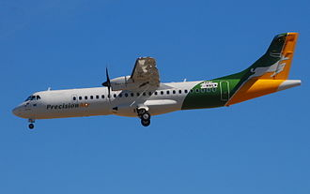

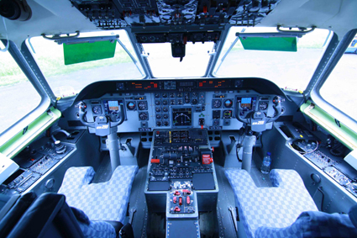
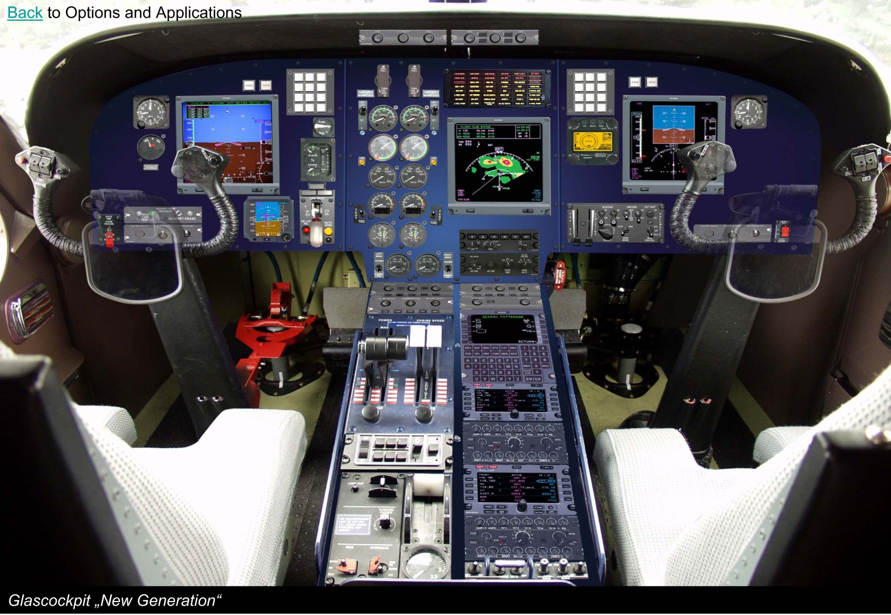
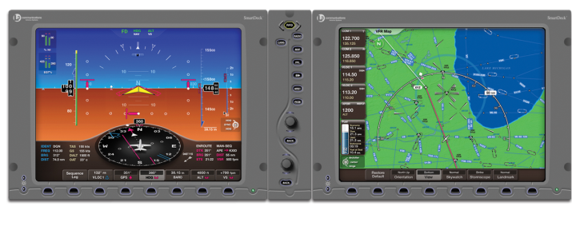
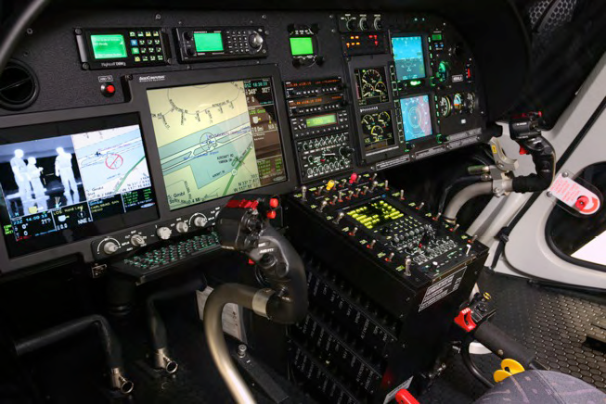
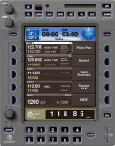
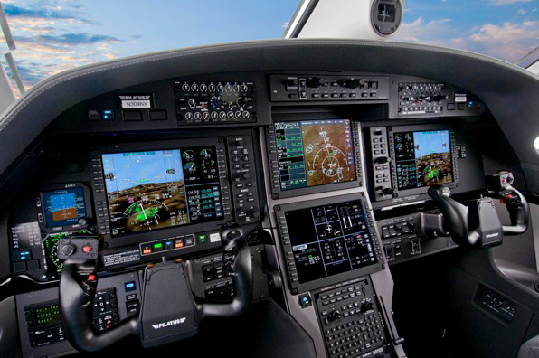
Becker Avionics AviaSynthesys© OEM Solutions Team
The Becker Avionics AviaSynthesys© fundamental business approach is collaboration with the OEM client from concept through execution & growth, delivering competitive AviaSynthesys OEM solutions, measurably adding significant value to the OEM client’s business.
Requirements
Certification
Positioning
Customer Support
Evolution

Slide 3
The Industry Challenge
Creating & Evolving Retrofit & Forward Fit Avionics Suites
Competing In A Market Dominated By a Few Entrenched, Incumbent Avionics Entities
Funding, name recognition, installed base & other barriers to entry
Time To Market Issues For Incumbents – except Garmin?
Balance Technology & Affordability
Retrofit vs. Forward Fit
Is the solution good enough for retrofit? Affordable? Non-traditional with new or different solutions?
Is the solution attractive enough for new platforms? Affordable?
Adapt currently available or emerging re-work of traditional solutions
Affordable
Good enough for retrofit
Good enough for forward fit, IFF priced to win
MAKE, BUY or ALLIANCE?

Slide 4
AviaSynthesys Custom OEM Solutions Concept
Collaborative
Build To Demand - Meet Only Needed Requirements With Becker CNS, ICS/ DVCS Solutions
Interface to FMS, EFIS or Otherwise As Needed
Special Functions Available – NVIS (Tempest Com Under Consideration)
Competitive
A Key To Creating Competitive, Comprehensive OEM Avionics Suite
Affordable Unit Pricing or Bundled Packages
Lower Time To Market (TTM)
Adds Solutions Not Available To Most OEMs; ICS/ DVCS
Value-Added
Avoids Development Non-recurring Costs & Enables Flexibility With OEM Scarce Resources
Positive Cash Flow Impact vs. NRCs
Comprehensive Package, Differentiating OEM’s Solution
Evolving New, Updated Solutions As Needed

Slide 5
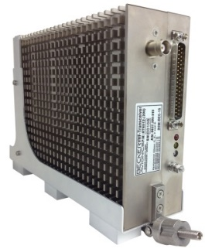
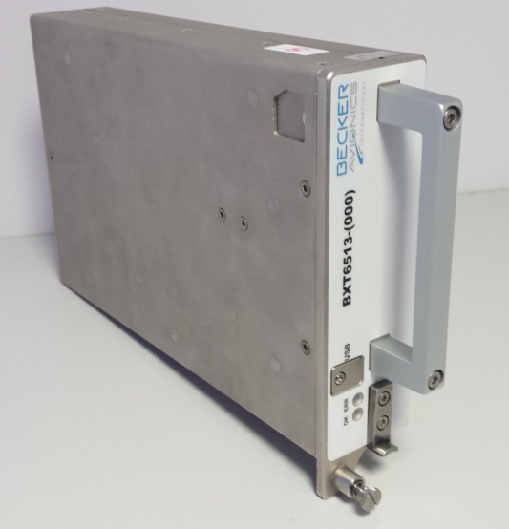
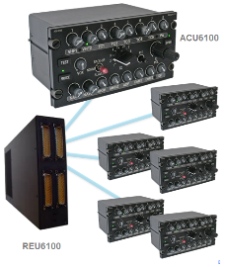
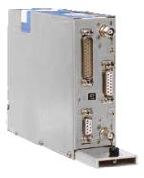
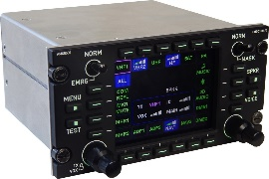
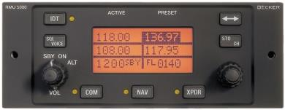
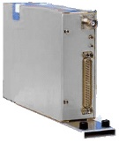
AviaSynthesys Solutions – Balanced Approach, Solutions … plus
Communications
VHF Transceiver
RMU – Radio Management Unit
ICS/ DVCS Intercommunications Systems/ Digital Voice Communications Systems
VHF Data Communications (VDL Modes 1 & 2)
Navigation
VOR/ ILS (LOC/GS)
MKR – Marker Receiver
ADF Receiver
DME - Distance Measuring Equipment
Nav/ Com Combined LRU
VOR/GS/LOC/Marker Beacon + Voice VHF-AM Airborne & Extended Freq + VHF Data Modes 1 & 2
Surveillance
Mode-S Non-TCAS II
Mode-S TCAS II

Slide 6
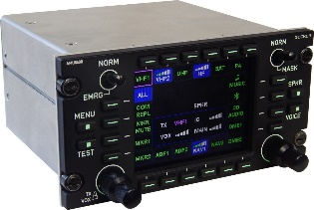
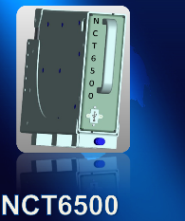
AviaSynthesys Solutions Availability & Planning
In Serial Production
Digital Voice Communications Systems DVCS61XX
VHF Com RT6512
NAV RN3320
ADF RA3502
Marker Beacon MRK3300
Mode-S/ ADS-B OUT Non-TCAS II BXT6513
In Development (Estimated Cert/Completion Date)
DVCS 65XX (Panel Mount Systems) (Q4 2018)
Mode-S TCAS II Transponder BXT6553 (Q4 CY 2018)
Mode-S Transponder Control Panel RCU6513 (Q1 CY 2019)
NCT65XX Nav/Com (Schedule TBD, WIP Tentative ATP)
Candidates For Product Road Map (ROM Estimate 24 Months Each, T ‘0’ At ATP)
ADF65XX (Response to RFI)
DME65XX (RFI Expected End August 2017)
VDR65XX VHF Voice/ Data Radio (Under Evaluation – Airframe & Avionics OEM Interest)
DME + Mode-S BXT65XX (Under Evaluation – Airframe & Avionics OEM Interest)

Slide 7
AviaSynthesys Typical EFIS/ FMS Interface
OEM EFIS

Slide 8
Why Becker AviaSynthesys Solutions
Technical & Program
Successful Design, Development Experience Proven Over +35 Years
Designed As Agreed, Works First Time & Stays On The Aircraft
Higher-Than-Industry Norm Environmental Standards For New Product Solutions, Some Updates
i.e. No Cooling Air, -55C to +70C Ops, Unpressurized/ Non-Temperature Control To 55,000 Ft, HIRF Lightening To IFR/IMC Operations
Dedicated Technical & Program Oversight, Coordination, Management Driving Execution
QMS Processes - Multiple OEM Quality System Approvals & ISO 9100
EASA and FAA Part 21 & 145 Authorizations
Cost of Ownership
Affordable Buy In & Life Cycle Costs
Industry High MTBUR/F Via In Service Metrics
Stays Relevant - Path To Upgrades, Updates and Redesigns
Product Support
Experienced OEM Support Specialists
Time Zone Sensitive – Europe & North America Based Support

Slide 9
AviaSynthesys Requirements Capture & Discussion
Pre-Engagement Business Process
Non-Disclosure Agreements
Technical Data Available As Needed – AviaSynthesys & OEM Client
RFI/P Available, With SOW & Schedules?
Budgeted Costs For Bought In Avionics?
Post-Engagement Business Process
Contractual
Development Coordination & Support
Post-Delivery, Pre-Deployment Expectations
Order Administration
Post Deployment Expectations
OEM & End-User Order Administration
Technical & Customer Support
Performance Metrics
Build Custom OEM Solution
Target End-User Platform?
Development Support Expectations
Specific Mechanical Architecture
Specific Interface Architecture
Certification Requirements
Integration Testing Expectations
Host Avionics & Structure?
Target Reliability Metrics?
OEM Support Structure & Requirements?
Schedule Expectations?

Slide 10
Next Steps?

Slide 11
Becker Avionics Group AviaSynthesys© OEM Solutions Collaborative, Competitive & Value-Added
Becker Avionics Group Headquarters
Becker Avionics GmbH
Baden-Airpark B108
77836 Rheinmuenster, Germany
Contact: info@becker-avionics.com
www.becker-avionics.com

