Slide 1
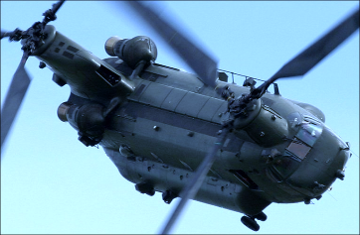
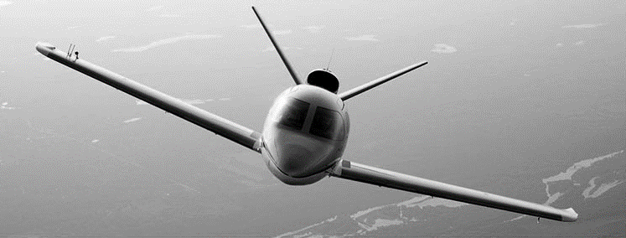

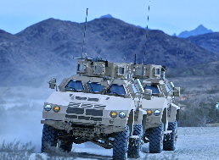








Slide 2
Agenda
Objective
RAMI Introduction
RAMI Product Portfolio

Slide 3
Why RAMI
RAMI is interested in the acquisition of Becker France
Intention to continue current production and customers
Transparent, uninterrupted, improving supply chain to Becker
RAMI is keenly interested in establishing a European presence
Base of operation to establish antenna and product business
Expansion of supply chain to serve current and future projects
Supply chain for internal needs
Who is RAMI?

Slide 4
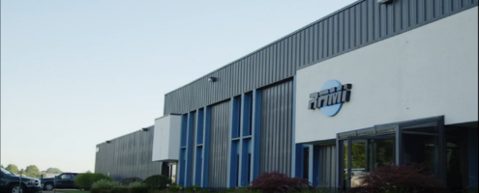

Company Overview
Founded 1954
Leading supplier of advanced antenna systems and RF components
US Military
Aviation
Heavy Truck
Privately held, 100% woman owned, small business
Headquarters: Grand Haven, Michigan USA

Slide 5
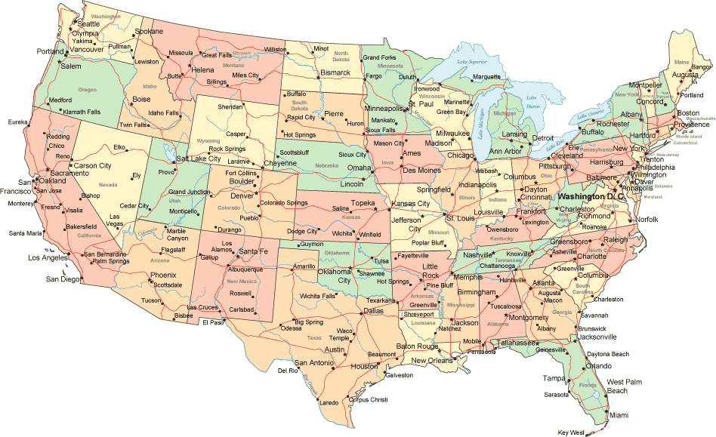
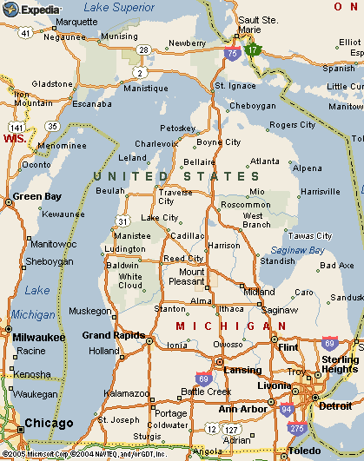
RAMI Location
Grand Haven, Michigan
Near Lake Michigan, 5th largest fresh water lake in the world
Growing community, attractive to …
Near Grand Rapids, 2nd largest city in Michigan
Grand Haven “Coast Guard City USA”
Recreation and tourism attractions
Growing, vibrant community
Within 50 miles of 27 colleges and universities
RAMI
GE Aviation
L3 Avionics Systems
Eaton
Amphenol Borisch

Slide 6
RAMI At A Glance
Big deal with military HEMS
Key supplier for ADS-B market
Trucks and boats

Slide 7
Company History
1954
Robert Miller founded R.A. Miller Industries
1987
Robert M. Lynas Purchases RAMI
1992
RAMI acquires general aviation product line from Antenna Specialists
Military
Aviation
1956
RAMI begins manufacturing military antennas
Heavy Truck
1993
RAMI enters heavy truck antenna market (Volvo)

Slide 8
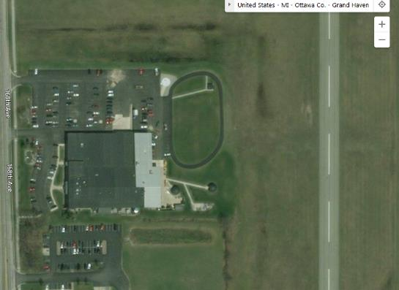
RAMI Facilities
100,000 Sq ft
Main building
Manufacturing
Engineering
Administration
Second building
Test chambers
Inventory
Expansion to include…
Located at Grand Haven Airport

Slide 9
Testing Capabilities
Qualification Testing
Internal
DO-160G & MIL-STD-666
All environmental tests except HIRF
External
DO-160G & MIL-STD-666
HIRF and Lightning
Elite (Chicago)
Ajax (Grand Rapids)
Performance
Anechoic chambers
DC – Daylight
Free-air antenna range
Turntable to 25 tons
10Hz to 1,000GHz

Slide 10
RAMI People
Growing Staff
Expect to add
Design Engineers
Production staff
Sales staff
Coverage of European market
Staff Demographics
100 Employees
Engineering
20 degreed engineers
10 technicians
Production
30 certified assemblers
20
Administration

Slide 11












RAMI Tools
Mechanical Engineering
PTC Creo
Windchill
Software Engineering
MS Visual Studio
Code Composer Studio
IBM Rational RT
Vector Cast Hardware Engineering
OrCAD
Xilinx, Altera FPGA Tool-Chains
Model Sim
Pspice, LTspice,WinSmith,
Config Management
Source Gear Vault
Issue Tracking
Bugzilla
Simulation / System Engineering
Matlab / Simulink
Polarion
Document Management / Archive
Part Lists, Industrialization
IFAX (ERP)
Project Planning
MS Project
Test Automation
LabView
Obsolescence Mgmt
Silicon Expert BOM Manager

Slide 12
Technologies & Expertise
EXAMPLE
Embedded Realtime Software DO-178 (up to DAL B)
µP: TI OMAP, ARM9, PIC, Fujitsu MB90F54, HCS08, 8-32 bit
DSP 16/32 bit, TI 5xxx, 6xxx, OMAP
Language C
Digital Signal Processing
Algorithms: Mixing, Scaling, AGC, NR, 3D Audio and more
Configuration Software
Windows, C++, C#, Delphi
Test Automation
Windows, C++, C#, Labview

Slide 13
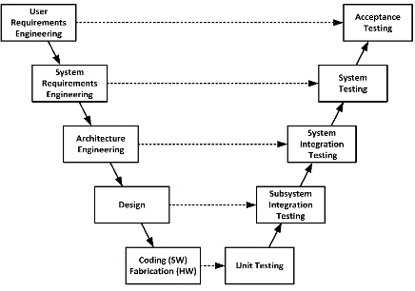
Design & Development Process
EXAMPLE
DO-178 DO-254 DO-160
PR
PDR
B-Mod
CDR
FAI
QR
SOP
A-, B-, C-Model
Need
Product
MRS
SYRD, PHAC, PSAC, ICD
HRS, SRS
HDD, SDD
MDD, EDD
ATR, ATP, QTR, QTP,
DDP
SWAS, HAS
TP, TR, SWCI, HWCI, MCI
SWVD, HWVD
Support
Processes
Proj.M
Config.M
Change.M
Dev.Stds

Slide 14


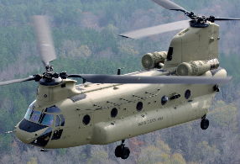




Markets
Military Land, Sea, and Air
Aviation
Heavy Truck

Slide 15































Customers
US Government
Defense and Aerospace
Aviation
Heavy Truck

Slide 16
Key Programs - Military
SINCGARS – Single Channel Ground and Airborne Radio System
1977
Present
EPLRS – Enhanced Position Location and Reporting System
1992
Present
FCS – Future Combat Systems
2003
2009
HMS – Handheld Manpack & Small Form Fit
2006
2040

Slide 17

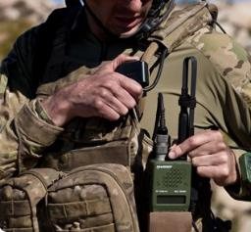

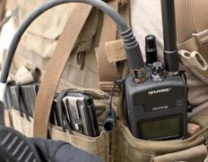
Military Handheld Examples
Long blade VHF
Short blade wide band UHF/VHF
ISR & GPS
Rubber Duckie wide band UHF/VHF

Slide 18
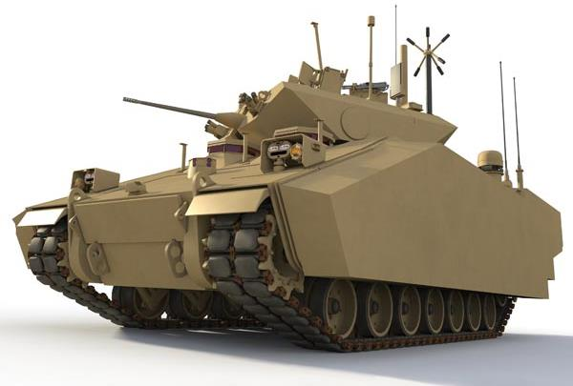
Military Vehicular Examples
Broadband communications
VHF Communications
GPS L1/L2
Diplexers/Triplexers
Antennas Risers

Slide 19



Military Airborne Examples
Glide slope
Radar interrogation
Communications
Marker beacon
Identification beacon
IFF

Slide 20


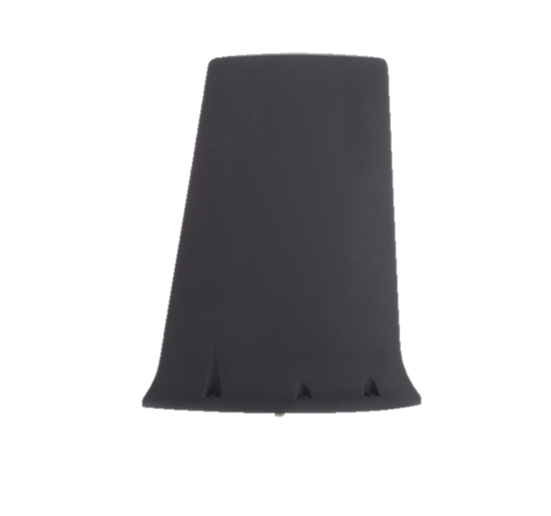
Military Airborne Examples
E-4B Airborne strategic command control post
High power
UHF communications
OV-1D Light attack and observation aircraft
VHF/UHF Communications

Slide 21
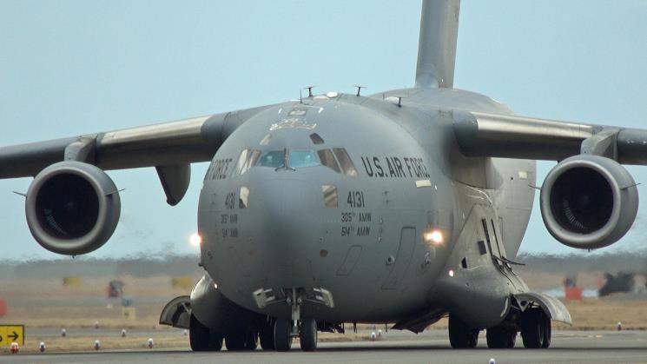
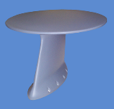
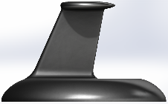
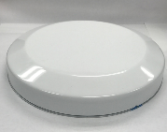
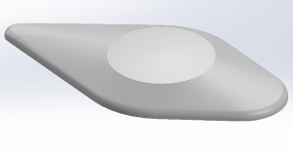
Conformal Antenna Development

Slide 22
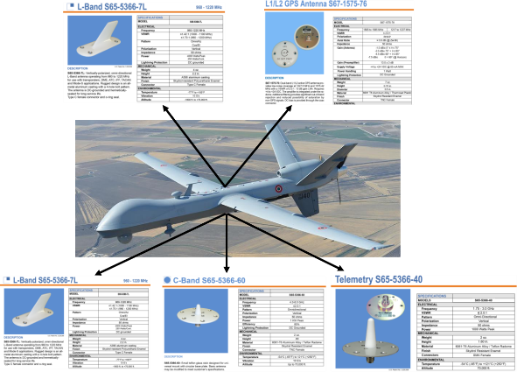
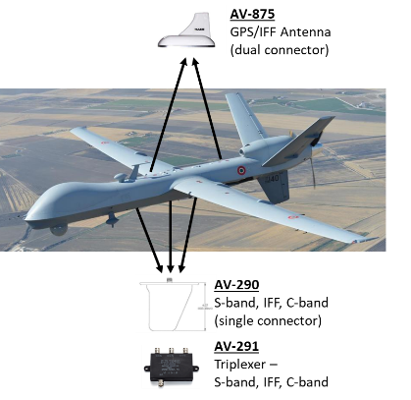
Antenna Consolidation

Slide 23





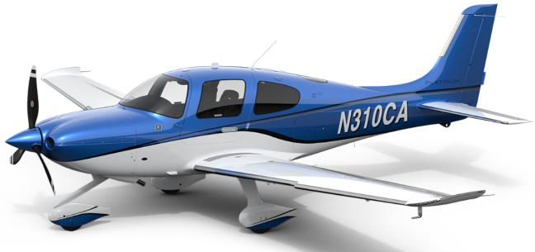


General Aviation Examples
Communications
GPS
VOR
Localizer
Glide Slope
Marker Beacon
Transponder
DME
ADS-B
Diplexers
Triplexers
Combiners

Slide 24
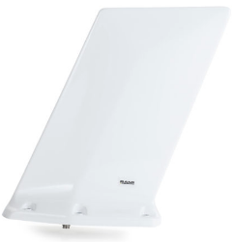

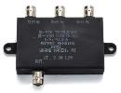
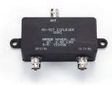
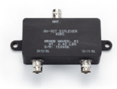
AV-925
AV-926
AV-927
AV-928
AV-929
AV-930
AV-931
AV-932
AV-933

Slide 27


Slide 28
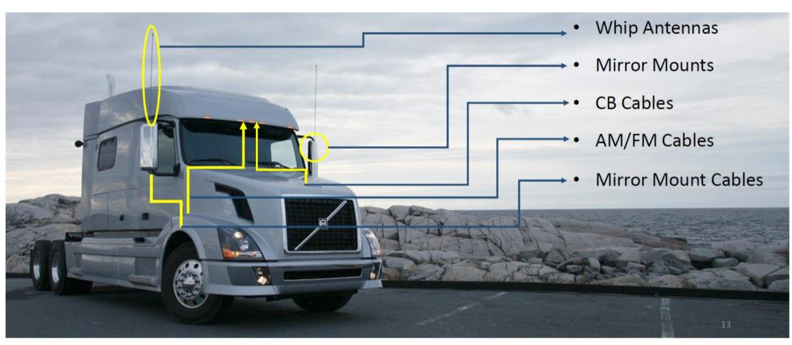
Heavy Truck Example

Slide 30



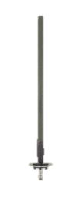

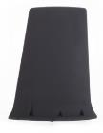



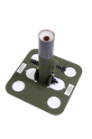



RF Competencies
Antennas
HF-20 GHz
Filters & couplers
LF to 20 GHz
System design
Power
Propagation
Protocols
Link reliability
Co-site mitigation

Slide 31
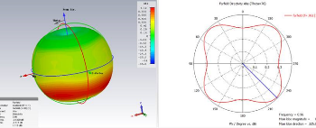
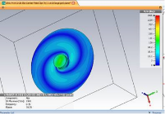

RF Design Capabilities
Software
CST Microwave
Filter Solutions
Orbit FR 959 Spectrum & DataPro
SOLIDWORKS 3D + PCB
Precision 2 and 4 port network analyzers
Anechoic chamber 16’x’16’x32’
500 MHz – 20 GHz
Dual axis positioner
25’ diameter RVTP (Rotating Vehicular Test Platform)
Outdoor ground reflection test range with AZ over EL positioner
(2) 26’ diameter test domes

Slide 32

Anechoic Chamber
16’x16’x32’ rectangular anechoic chamber
500 MHz through 20 GHz
Dual-axis antenna positions (roll over Azimuth)
Orbit FR 959 spectrum software (with circular polarization)
Orbit FR AL-4806-3A positioner controller

Slide 33
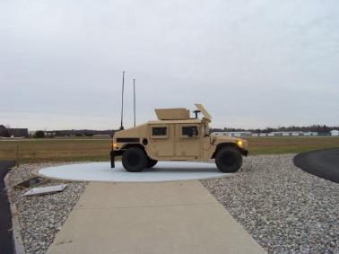
Outdoor Test Ranges
25’ Rotating Vehicular Platform
30,000 LB limit
26 MHz to 6 GHz
Azimuth positioners only in linear or circular polarization
Orbit FR 959 spectrum software with AL-4806-3C positioner controller
Rooftop Ground Reflection Range
Dual axis (AZ over EL) on roof of 10’x10’x10’ range building
26 MHz to 6 GHz
Azimuth and elevation patterns in linear or circular polarization
Orbit FR 959 spectrum software with AL-4806-3C positioner controller

Slide 34
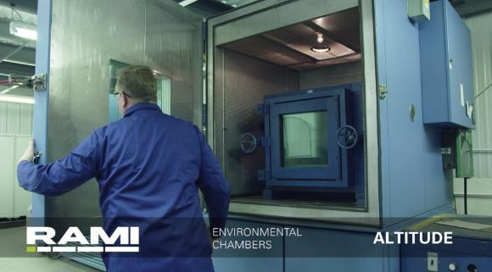
Environmental and Mechanical Test Capabilities
Altitude chambers – 100,000 ft.
Salt fog chamber
Wind & rain
High - low temp chambers
Humidity & temperature chambers
Water immersion
Bounce loose cargo
Ballistic shock and vibration
Side load
Spring flex
Impact test track
FAA TSO

Slide 35
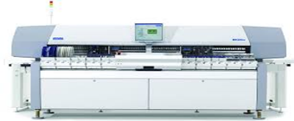
Assembly Capabilities
Mycronic SMT Line (pwb assembly)
Multiple Schlueniger cable processing machines
Multiple Schlueniger crimping machines
Pull test equipment
Multiple Spirig precision soldering/welding equipment
Multiple metered epoxy/foaming equipment
Multiple marking machines
10,000 sq. ft. of fiberglass tube processing facility which includes precision cloth cutting, ovens, tape roll, grinders and sanders
Multiple soldering equipment stations – including scopes and cameras
Resistive soldering equipment - custom
Multiple general assembly areas with custom fixtures, autofeed screwdrivers, in-line testing, etc.

Slide 36
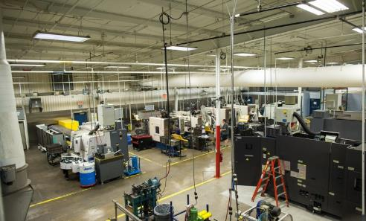
Vertically Integrated Design, Manufacturing & Testing
110,000 SQ/FT facility
Latest CNC equipment
Multi-axis
CNC lathes and mills
Flexible lean manufacturing centers
Proprietary machine design and installation
Maximize control for superior quality, schedule, and cost

Slide 37
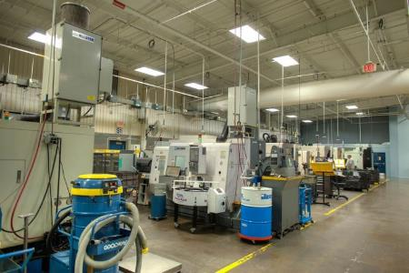
Machining Capabilities
1 Okuma MacTurn – Multifunction/multi-axis
1 Okuma Multus – Multifunction/multi-axis
2 Okuma LT200 – Multifunction/multi-axis
6 Various Okuma and Miyano – STD CNC lathes
4 Miyano – STD CNC mills
Utilize GibbsCAM for programming
RAMI invests in the latest machining technologies and competencies

Slide 38
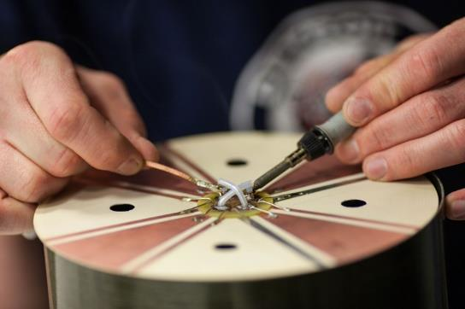
Rapid Prototyping Capabilities
Dedicated Engineering Design Center
Dedicated CNC equipment and personnel
Circuit board prototype capability
3D printing
3D design analysis
RAMI thrives on rapid response to customized requirements

Slide 39
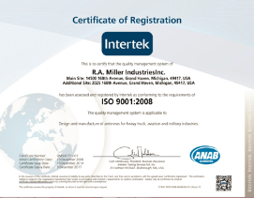
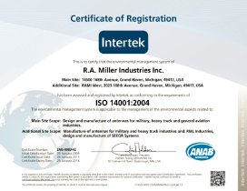
Quality
ISO 9001:2015 certified
ISO 14001:2015 certified
AS9100 compliant
General aviation products are FAA TSO approved
MIL standards: STD-810, Q-9858
Corporate culture focuses on the mission critical nature of our products

Slide 40
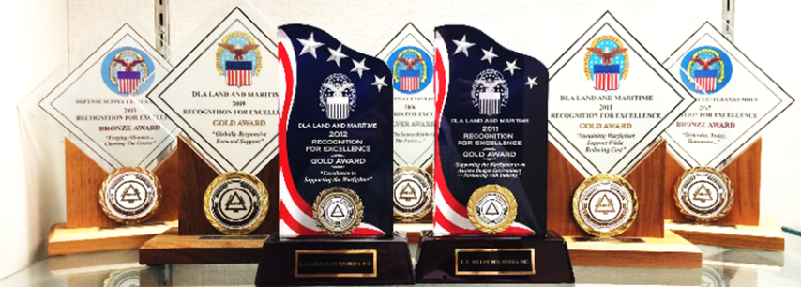
Awards
DLA & Maritime Gold Awards
(100% delivery 100% quality)
Presented to only 0.5% of suppliers annually
RAMI received Gold every year back to 2009

