Slide 1
ODA Email Campaign
Success! As measured by:
Publication placement following press list blast
Aero-News Network
AINonline
Business Air News
AvWeek
Number of opens (398) and clicks (23) out of 1213 deliveries
Action tracked by website visits
Total volume following email blast
Number of new visits

Slide 2
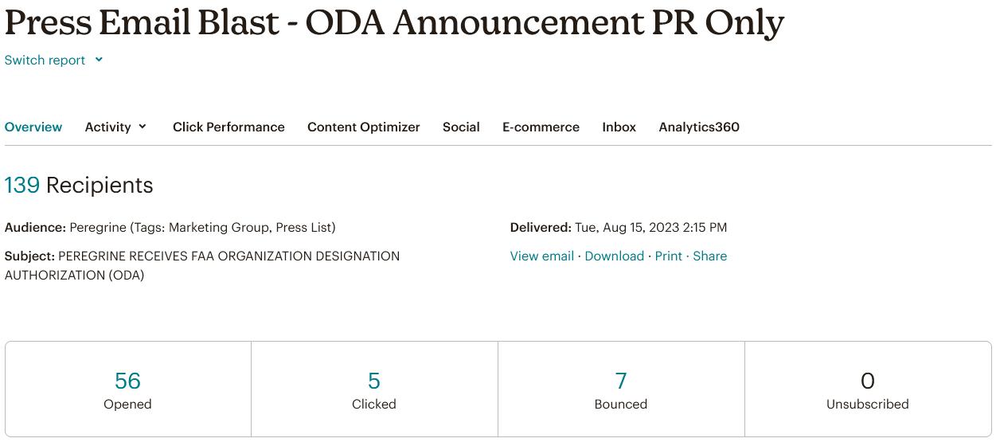
Press Email Blast

Slide 3
Press Release Publication
Aero-News Network
AINonline
Business Air News
AvWeek

Slide 4
AEA Response
Ready to do a podcast with Peregrine
Questions sent
Sept 22?
Ready to do a Member Profile

Slide 5
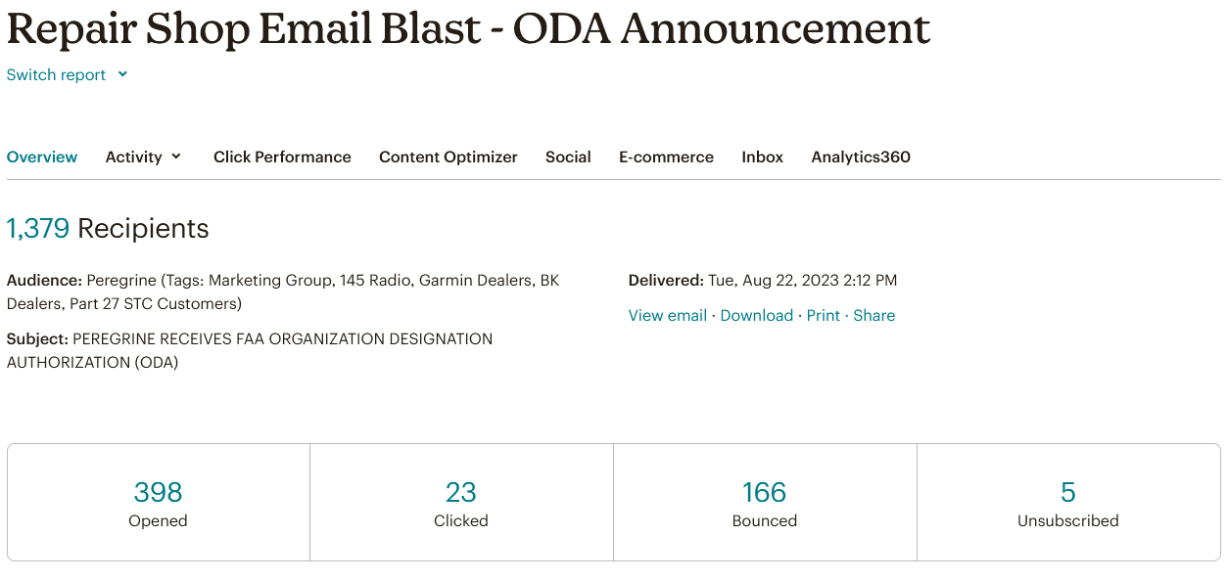
Email Blast

Slide 6
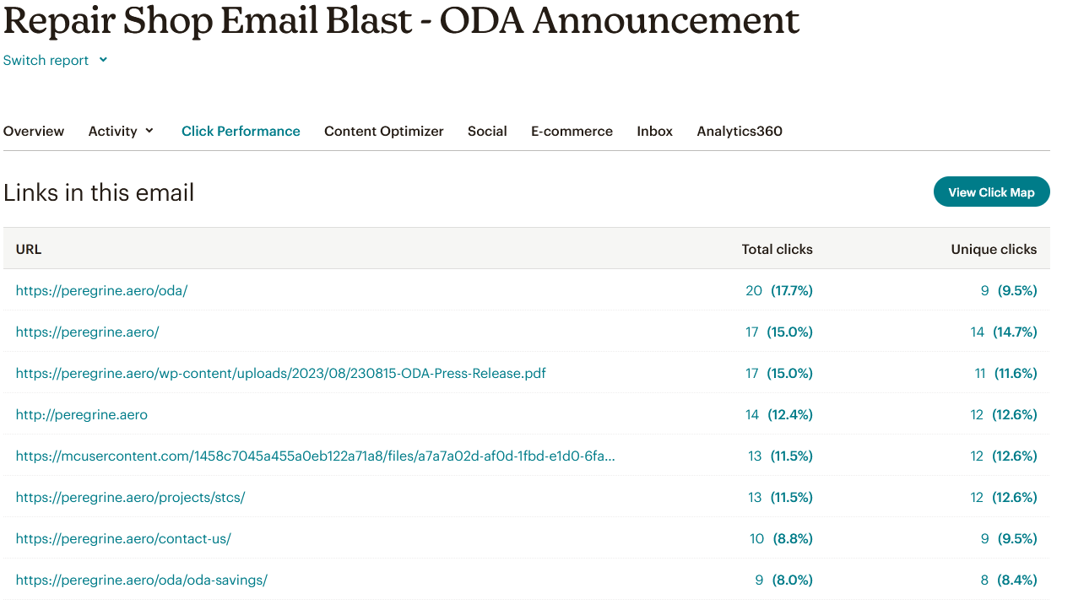
Press Release
Press Release

Slide 7
1 VISION AVIATION PLLC
45 North Aviation, LLC
702 HELICOPTER
ABILENE AERO
ABTEC HELICOPTERS LLC
ACE AVIATION
ACE AVIATION INC
ACHIEVEMENT AVIATION LLC
ACI JET
ADVANCETECH AIRCRAFT MAINTENANCE INC
AERO AVIONICS INC
AERO CHARTER INC
AERO COMPOSITES AND STRUCTURES INC
AERO DYNAMIX INC
AERO ELECTRONIC MALTER GMBH & CO. KG
AERO ENGINEERING SUPPORT LLC
AERO INDUSTRIES INC
AERO PRO AVIONICS
AEROBRIGHAM
AEROSECURE LLC
AEROSMITH AVIONICS
AEROSPACE INSTRUMENT SUPPORT
AEROSPACE QUALITY RESEARCH AND DEVELOPMENT 145 LLC
AEROSPACE TECHNOLOGIES GROUP INCORPORATED
AEROTEK DESIGN LABS LLC
AEROTRONICS OF MISSOULA
AGUSTAWESTLAND PHILADELPHIA CORPORATION
AH AERO SERVICES LLC
AIR CENTER HELICOPTERS INC
AIR METHODS CORP
AIR ONE SYSTEMS LLC
AIRBASE SERVICES INC
AIRCRAFT INTERIORS UNLIMITED INC
AIRCRAFT WELDING INC
AIRWOLF AEROSPACE LLC
ALASKA AIRCRAFT SALES INC
ALPHA AIRCRAFT SERVICES OF AMERICA INC
ALPINE AVIATION INC
AMAC AEROSPACE TURKEY
AMI AVIATION SERVICES
AMI AVIATION SERVICES LLC
ANGELO PRECISION AIRCRAFT LLC
AOG-ASAP AVIONICS
ASAP AVIONICS SERVICES
AUTOPILOTS CENTRAL INC
AVCON INDUSTRIES INC
AVEMEX
AviaGlobal Group, LLC
AVIATION CLASSICS
AVIATION ENTERPRISES INC
AVIATION FABRICATORS INC
Aviation Partners Group
AVIATION SPECIALTIES UNLIMITED INC
AVIATION TECHNICAL SERVICES INC
AVIDYNE CORPORATION
AVIONICS & MAINTENANCE WEST
AVIONICS MASTERS INC
Avionics Sales Corporation
AVIONICS SERVICES
AVIONICS SERVICES INTL INC
AVIONICS SHOP
AVIONICS SPECIALISTS
AVMATS JET SUPPORT
AVTECH SERVICES
AVWORKS AEROSPACE
BANYAN
BAY AVIONICS LTD
BELL TEXTRON MIAMI INC
BETTER AVIATION PRODUCTS INC
BIGHORN AIRWAYS INC
BISON AVIATION
BLACK MOUNTAIN AVIONICS
BLUE RIDGE HELICOPTERS INC
BLUSKY AVIONICS
BOCA AIRCRAFT MAINTENANCE
BORSIGHT AVIONICS LLC
BOX AVIATION INC
BROADIE
BRUNSWICK AVIATION SERVICES LLC
BUCHER AEROSPACE CORPORATION
BURLINGTON AIR CENTER
BUTLER AVIONICS INC
BYERLY AVIATION
C J AVIATION INC
CALIBRO AVIONICS
CALVIN TAFF ELECTRONICS
CAM AVIONICS
CAMETOID TECHNOLOGIES INC
Canadian Avionics and Instruments Ltd
CANANDAIGUA AIR CENTER LLC
CANYON AERO
CAPITAL AVIATION
CAROLINA AVIATION TECHNICAL SERVICES LLC
CAROLINA AVIONICS GROUP LLC
CARPENTER AVIONICS INC
CARSON HELICOPTERS INC
CASCADE AIRCRAFT MANAGEMENT
CASCADE HELICOPTER SERVICES
CASTLEBERRY INSTRUMENTS AND AVIONICS LLC
CEF INDUSTRIES LLC
CENTURY HELICOPTERS
CHANDLER AVIONICS
CIVIC HELICOPTERS INC
CLASSIC INTERIOR COMPLETIONS INC
COASTAL WINDS AVIONICS
COLUMBIA AIR SERVICES INC
COMLUX AMERICA LLC
COMMANDER INSTRUMENT & AVIONICS
COMMONWEALTH AVIATION SERVICE INC
CONDOR AVIONICS & AIRMOTIVE
CONSTANT AVIATION LLC
CORPORATE AIR
CORVALLIS AERO SERVICE
COURTNEY AVIATION INC
CRAIG AVIONICS
CROMAN CORP
CRUISE AIR AVIATION INC
CRYSTAL AVIONICS
CUSTOM AIRCRAFT INC
CUTTER AVIATION PHOENIX INC
D AND D BALLOONING
DAKOTA CUB AIRCRAFT INC
DAVIS FIELD AVIATION LLC
DENMEN INTERNATIONAL TRADE INC
DES MOINES FLYING SERVICE INC
DLK AVIATION
DRETLOH AIRCRAFT SUPPLY INC
DUNCAN AVIATION - ATLANTA
DUNCAN AVIATION - BATTLE CREEK
Duncan Aviation - St. Paul
DUNCAN AVIATION INC
DYNAMO AVIATION INC
EAGLE AVIONICS
EAST WEST AVIONICS
EASTERN CINNATI AVIATION INC
EASTERN L
EASTWEST AVIONICS INC
EATON AEROSPACE LLC
ELECTRONIKS
ELITE AVIATION SERVICE LLC
ELITE AVIATION SERVICES INC
ELITE AVIONICS SERVICES
ELLIOTT AVIATION OF THE QUAD CITIES LLC
ELLISON AVIONICS SERVICES LLC
EPPS AIR SERVICE INC
ERA HELICOPTERS LLC
ERIC'S LEADING EDGE INC
EUROTEC VERTICAL FLIGHT SOLUTIONS
EXECUTIVE AIR TAXI
EXECUTIVE AVIONICS INC
EXECUTIVE HELIJET AVIATION
FALCON CREST ACCESSORIES INC
FARGO JET CENTER LLC
Fieldtech Avionics Inc.
FIRST FLIGHT AVIATION
FIRST WING JET CENTER
FLAG PRECISION CORP
FLAME SPRAY INC
FLIGHT RESEARCH INC
FLIGHTLINE GROUP
FLY HANGAR 13 LLC
FLYCAROLINA AVIATION
FREEDOM AVIATION
FRESNO FLIGHT AND AIR REPAIR LLC
GARDNER AVIATION SPECIALIST INC
GEF AVIATION
GEMCO AVIATION SERVICES
GEORGIA AVIONICS
Georgian Aerospace LLC
GIBSON AVIATION SERVICES LLC
GLENDALE AERO SERVICES
GLOBAL AVIATION TECHNOLOGIES LLC
GOAEROMX
GOODYEAR TIRE AND RUBBER CO AVIATION PRODUCTS DIV
GREEN MOUNTAIN AVIONICS
GRIFFIN AVIONICS INC
GTA AIR INC
HAECO CABIN SOLUTIONS LLC
HARRISON AVIONICS
HARTSELL AVIONICS
HEADS UP TECHNOLOGIES INC
HEATH AVIATION
HEAVY METAL AIR LLC
HELEX LLC
HELICOMM AVIONICS
HELICOPTER PARTS AND SERVICE INC
HELICOPTER SERVICES INC
HELICOPTER STRUCTURES INC
HELICOPTER SUPPORT INC
HIGGINSVILLE AVIONICS
HIGH DESERT AVIONICS INC
HILLSBORO AVIATION INC
HONAKER AVIATION
HORIZON AVIONICS
HOUMA AVIONICS
IHP WORLDWIDE INC
INDY
INTERCONTINENTAL JET SERVICE CORPORATION
INTERMOUNTAIN AEROSPACE
INTERSTATE TURBINE MANAGEMENT
JAARS INC
JEFFERSON CITY FLYING SERVICE
JLC AVIONICS
JOHN JEWELL AIRCRAFT INC
JOLIET AVIONICS INC
JPS AVIATION LLC
KACHEMAK BAY FLYING SERVICE
KALAMAZOO AIRCRAFT INC
KENMORE AIR HARBOR
KING AEROSPACE INC
KINGMAN AIRLINE SERVICES INC
KITCHENER AERO AVIONICS
LAFAYETTE AVIONICS
LANMAR AVIATION INC
LEADING EDGE AVIONICS
LEARJET INC
LIVINGSTON AVIATION INC
LONDON AIRCRAFT SERVICE CENTER
LONDON AIRCRAFT SERVICE CENTER INC
LOWCOUNTRY
LUFTHANSA AVIATION TRAINING USA INC
LUMA TECHNOLOGIES
LV AVIONICS
LYCOMING ENGINES
M AND S AIR SUPPLY
MAC AIRCRAFT MAINTENANCE
MAC AVIONICS
MACHEN INC
MANAGERIE ENTERPRISES INC
MARTIN AIRCRAFT SERVICES LLC

Slide 8
MARTINAIRE AVIATION LLC
MATHER AVIATION VAN NUYS LLC
MAYDAY AVIONICS
MAYO AVIATION
MDS AVIATION
MICHIANA AIRCRAFT SERVICE
MID-SOUTH AVIONICS
MNG JET
MOBILE AVIONICS TECHNOLOGIES INC
MODERN AVIONICS & MAINTENANCE
MODERN AVIONICS AND MAINTENANCE INC
MONARCH AVIATION
MOOG INC
MURRAY AVIONICS
NATIONAL AIRCRAFT SVC
NATIONAL FLIGHT SERVICES INC
NATRONA AVIONICS
NEW ENGLAND PLASMA DEVELOPMENT CORP
NEWVIEW TECHNOLOGIES INC
NORTH COUNTRY AVIATION SVCS
NORTH TEXAS TURBINES INC
NORTHERN LIGHTS AVIONICS
NORTHROP GRUMMAN
NorthStar Helicopters
NORTHWEST HELICOPTERS INC
OASIS AVIATION MAINTENANCE
OCEANAIR
OCR AVIATION
OK3 AIR
OLYMPIA AVIONICS
ON THE BEAM AVIATION INC
ON WING
PACIFIC COAST AVIONICS CORP
PALM BEACH AVIONICS
PALMETTO AVIONICS
PAZ AVIATION INC
PEACE HILLS AVIATION
PENINSULA AERO TECHNOLOGY
PENINSULA AVIONICS INC
PENTASTAR AVIATION LLC
Peregrine
PHOENIX AEROSPACE INC
POMPANO AVIONICS CENTER
POMPANO AVIONICS INC
PORT CITY
PORT CITY AIRCRAFT REPAIR INC
PRECISION AERO TECHNOLOGY INC
PRECISION AIR
PRECISION AVIONICS INC
PRECISION AVIONICS SPEC
PRECISION HELI-SUPPORT
PREMIER AVIATION
PREMIER AVIONICS
PREMIER JETS COMPLETION CENTER INC
PRESTIGE HELICOPTERS INC
PROFESSIONAL PILOTS LLC
PWI INC
Q.F. Avionics Center Ltd.
QUALITY AVIONICS
R C AVIONICS INC
RADIAL ENGINES LTD
Rainier Heli International
RAUCH, LEW DSC
RAY'S AV
REDBIRD ELECTRONICS INC
REGENT AEROSPACE CORPORATION
RELIABLE JET MAINTENANCE LLC
RELIANCE AEROPRODUCTS INTERNATIONAL INC
RENDRAG AVIATION LLC
RESURGENT AVIATION SOLUTIONS LLC
ROBERTSON AIRCRAFT INC
ROCKWELL AUTOMATION INC
Rocky Mountain Aircraft
ROCKY MOUNTAIN AIRCRAFT SERVICES
ROCKY MOUNTAIN AVIONICS
ROGERS HELICOPTERS INC
ROSE AIRCRAFT SERVICES
ROSEN AVIATION LLC
ROTOR CONCEPTS LLC
ROTORCRAFT SUPPORT
ROTORTECH SERVICES INC
RSG AVIATION
RVR MAINTENANCE LLC
SAFRAN ELECTRONICS & DEFENSE, AVIONICS USA LLC
SANDER GEOPHYSICS LTD
SARASOTA AVIONICS
SAS PENNSYLVANIA INC
SEABOARD TANK SYSTEMS INC
SEBASTIAN COMMUNICATION
SEBRING AVIATION
Sinton Helicopters
SKYCOM AVIONICS
SKYCOM AVIONICS INC
SKYE AVIONICS Ltd.
SKYLOCK INDUSTRIES INC
SKYTECH INC KDMW MD
SOUTH CAROLINA AVIONICS SERVICE
SOUTHEAST AEROSPACE
SOUTHEAST AEROSPACE INC
SOUTHWEST AIRMOTIVE CORPORATION
SOUTHWEST AVIATION SPEC
SPARKCHASERS AIRCRAFT SERVICES INC
SPECIALTY AVIONICS
SPECTRA JET INC
Spirit Aeronautics
SPITFIRE AEROSPACE SERVICES INC
SRT AVIATION INC
STAR AVIATION INC
STAR AVIONICS
STAR GROUND SERVICES INC
STEINER
STERLING AVIONICS
STERLING HELICOPTER
SUMMIT AVIATION
SUMMIT HELICOPTERS INC
SUN VALLEY AVIATION
SUNRISE JETS MAINTENANCE LLC
SUPERIOR AVIONICS
SURVIVAL FLIGHT MAINTENANCE LLC
SWAMP FOX AVIONICS LLC
TAILWIND AVIATION SERVICES
TALON AIR MAINTENANCE SERVICES LLC
TAMARACK HELICOPTERS INC
TEXAS GYRO INC
TEXAS TURBINE CONVERSIONS
THE AVIONICS SPECIALISTS
THE RADIO SHOP
THORNTON AIRCRAFT COMPANY LLC
THREE WING AVIATION GROUP
TOLEDO JET CENTER
TOLEDO JET CENTER LLC
TOTAL AVIONIX INC
TRANSIERRA TECHNOLOGY
TREASURE COAST AVIONICS INC
TRIMEC AVIATION
TRINE AEROSPACE LLC
TT AEROTECH CORP.
TWIN MANUFACTURING CO
UHI INC
UNIFLIGHT LLC
UNIVERSAL AVIONICS SYSTEMS CORP
VENTURA
VIASAT INC
VICAVIONICS SA DE CV
WELLS AIRCRAFT INC
WESTERN AIRCRAFT INC
WESTERN JET AVIATION INC
WINGS AVIONICS INC
WISCONSIN AVIATION FOUR LAKES INC

Slide 9
Clicked Emails
Email Address | Company
office@aerosmithaviation.com | AEROSMITH AVIONICS
jeremy.bryck@airmethods.com | AIR METHODS CORP
marcus@avconindustries.com | AVCON INDUSTRIES INC
jeff.cornell@atsmro.com | AVIATION TECHNICAL SERVICES INC
fra@bucheraero.com | BUCHER AEROSPACE CORPORATION
sales@carpenteravionics.com | CARPENTER AVIONICS INC
rodm@carsonhelicopters.com | CARSON HELICOPTERS INC
edduyn.pita@duncanaviation.com | DUNCAN AVIATION - ATLANTA
josh.west@duncanaviation.com | DUNCAN AVIATION - BATTLE CREEK
tom.lieser@duncanaviation.com | Duncan Aviation - St. Paul
john.fisher@gas-az.com | GLENDALE AERO SERVICES
david@aerosmithaviation.com | HARTSELL AVIONICS
avionics@maineaviation.com | MAC AIRCRAFT MAINTENANCE
maintenance@macairgroup.com | MAC Aircraft Maintenance
sfalkner@maineaviation.com | MAC AIRCRAFT MAINTENANCE
sales@murrayavionics.com | MURRAY AVIONICS
lash@rainierheli.com | Rainier Heli International
rlryan@airmail.net | REDBIRD ELECTRONICS INC
kirk@sarasotaavionics.com | SARASOTA AVIONICS
trichardello@twinman.com | TWIN MANUFACTURING CO
michele.lehr@viasat.com | VIASAT INC
paulh@westair.com | WESTERN AIRCRAFT INC

Slide 10
Follow-up Strategy
Aerospace Edge to:
Follow-up call to clicked emails
Follow-up with personalized emails to opened emails
Calls to Peregrine identified targets in opened email list

