Slide 1
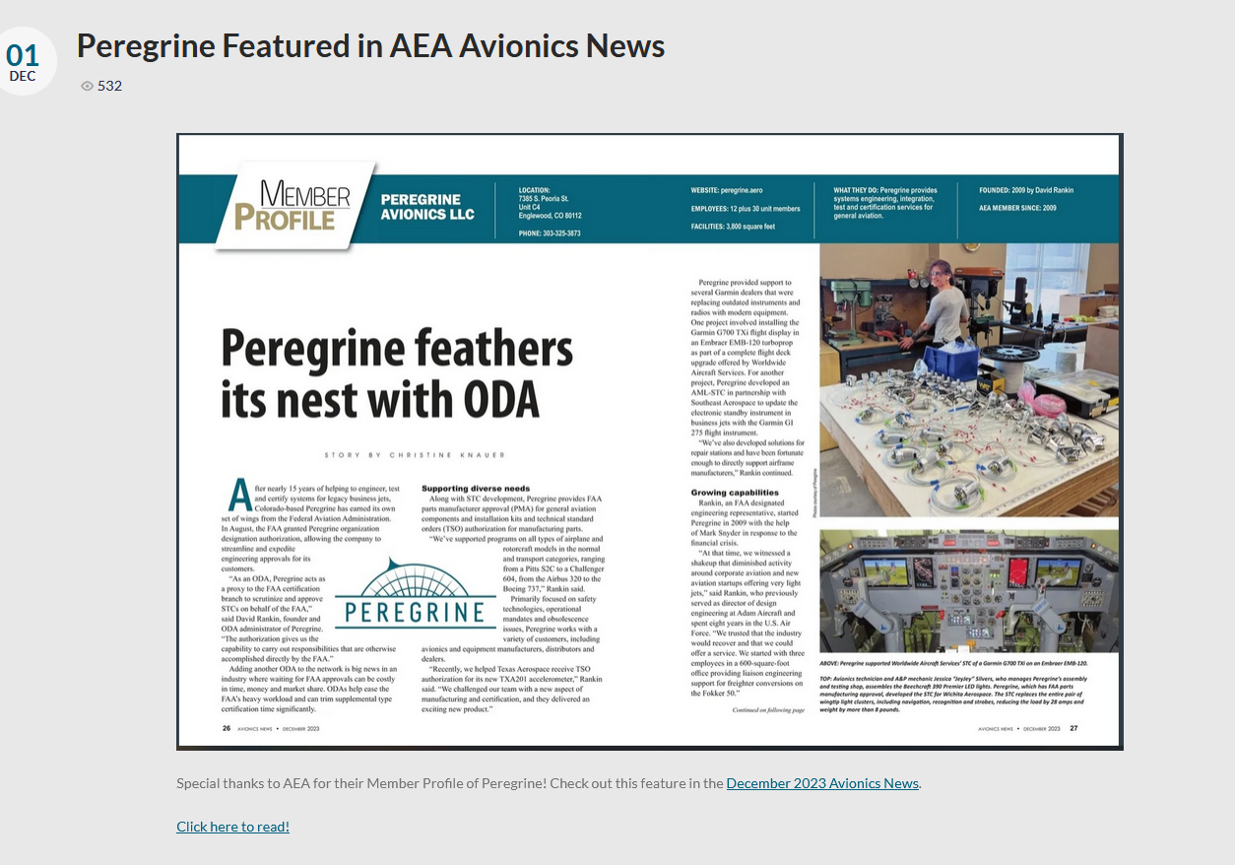
https://digital.avionicsnews.net/publication/frame.php?i=809276&p=&pn=&ver=html5

Slide 2
Special thanks to AEA for their Member Profile of Peregrine! Check out this feature in the December 2023 Avionics News.
Click here to read!
https://digital.avionicsnews.net/publication/frame.php?i=809276&p=&pn=&ver=html5
https://digital.avionicsnews.net/publication/frame.php?i=809276&p=&pn=&ver=html5

Slide 3
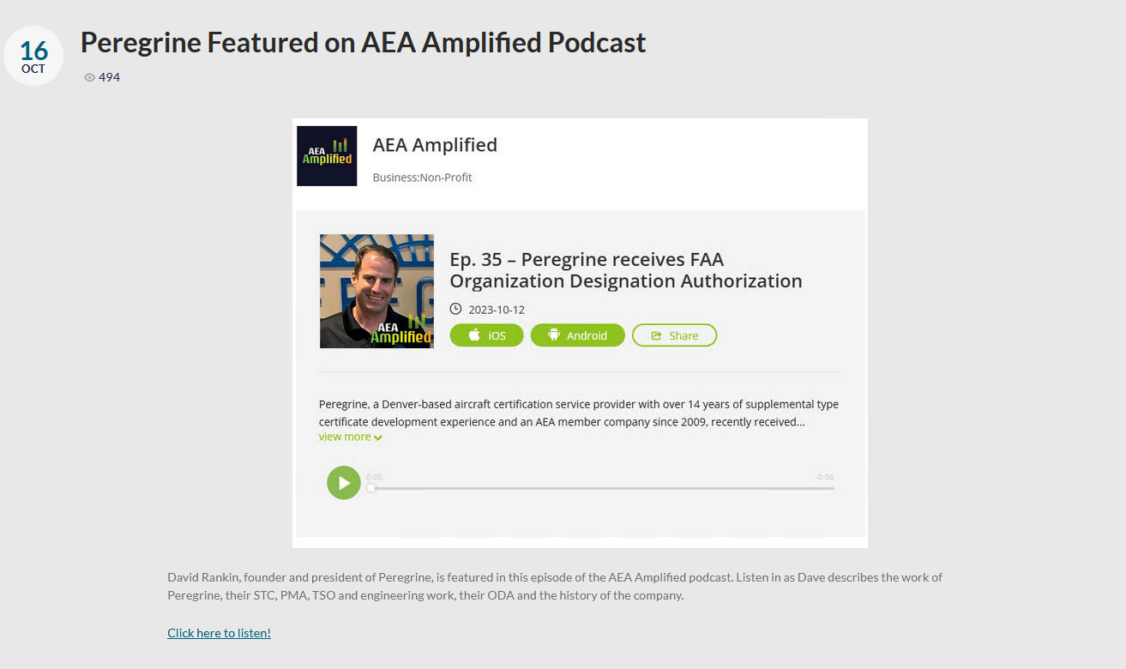
https://peregrine.aero/wp-content/uploads/2023/10/Peregrine-AEA-Amplified.jpg.jpg
https://www.podbean.com/ep/pb-fi7r7-14cd105

Slide 4
David Rankin, founder and president of Peregrine, is featured in this episode of the AEA Amplified podcast. Listen in as Dave describes the work of Peregrine, their STC, PMA, TSO and engineering work, their ODA and the history of the company.
Click here to listen!
https://www.podbean.com/ep/pb-fi7r7-14cd105

Slide 5
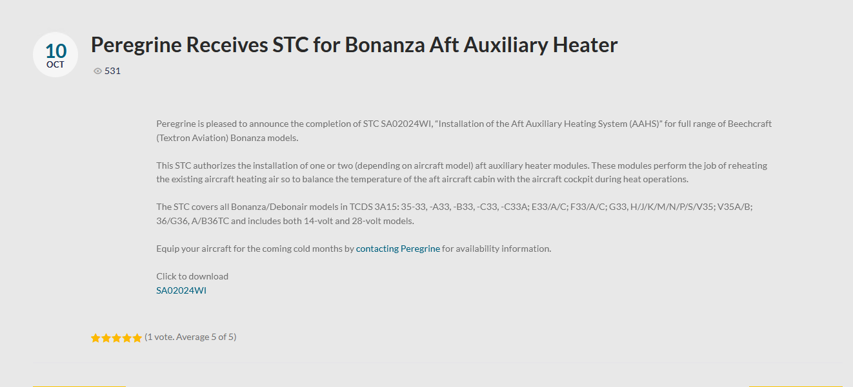

Slide 6
Peregrine is pleased to announce the completion of STC SA02024WI, “Installation of the Aft Auxiliary Heating System (AAHS)” for full range of Beechcraft (Textron Aviation) Bonanza models.
This STC authorizes the installation of one or two (depending on aircraft model) aft auxiliary heater modules. These modules perform the job of reheating the existing aircraft heating air so to balance the temperature of the aft aircraft cabin with the aircraft cockpit during heat operations.
The STC covers all Bonanza/Debonair models in TCDS 3A15: 35-33, -A33, -B33, -C33, -C33A; E33/A/C; F33/A/C; G33, H/J/K/M/N/P/S/V35; V35A/B; 36/G36, A/B36TC and includes both 14-volt and 28-volt models.
Equip your aircraft for the coming cold months by contacting Peregrine for availability information.
Click to download
SA02024WI
https://peregrine.aero/contact-us/
https://peregrine.aero/download/13284/?tmstv=1705174691

Slide 7
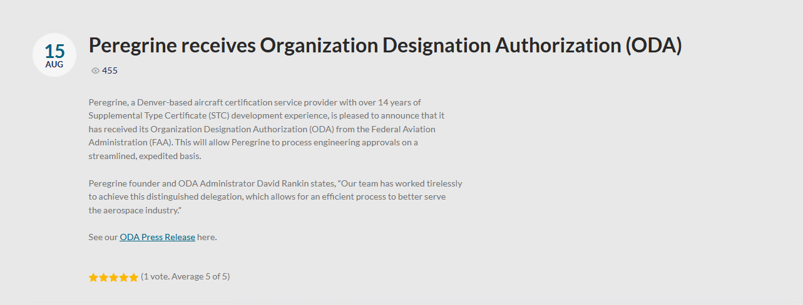
https://peregrine.aero/wp-content/uploads/2023/08/230815-ODA-Press-Release.pdf

Slide 8
Peregrine receives Organization Designation Authorization (ODA)
Peregrine, a Denver-based aircraft certification service provider with over 14 years of
Supplemental Type Certificate (STC) development experience, is pleased to announce that it
has received its Organization Designation Authorization (ODA) from the Federal Aviation
Administration (FAA). This will allow Peregrine to process engineering approvals on a
streamlined, expedited basis.
Peregrine founder and ODA Administrator David Rankin states, “Our team has worked tirelessly
to achieve this distinguished delegation, which allows for an efficient process to better serve
the aerospace industry.”
See our ODA Press Release here.
https://peregrine.aero/wp-content/uploads/2023/08/230815-ODA-Press-Release.pdf

Slide 9
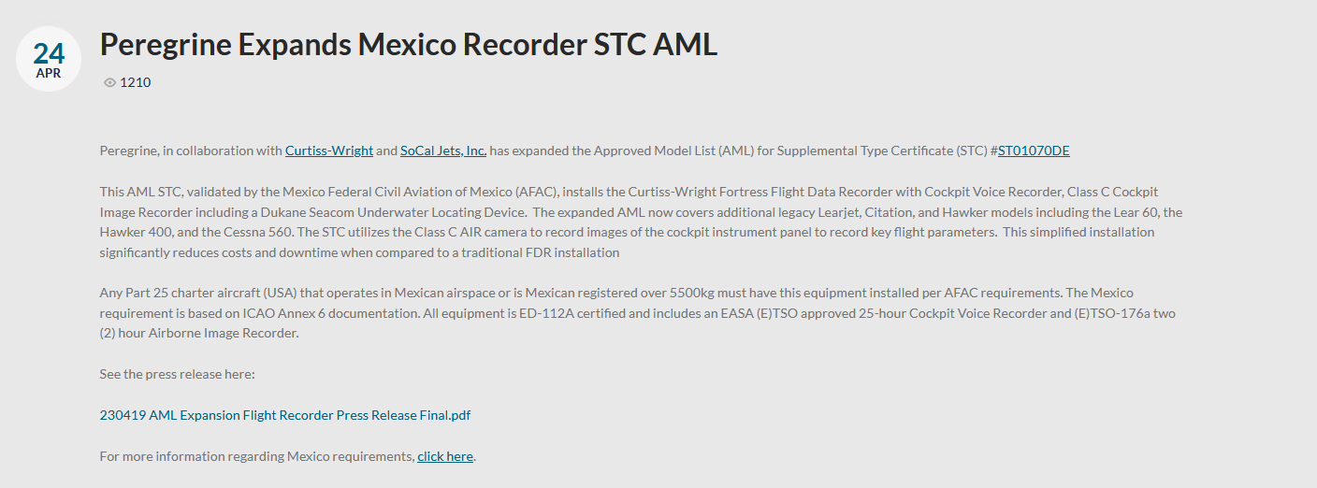

Slide 10
Peregrine Expands Mexico Recorder STC AML
Peregrine, in collaboration with Curtiss-Wright and SoCal Jets, Inc. has expanded the Approved Model List (AML) for Supplemental Type Certificate (STC) #ST01070DE
This AML STC, validated by the Mexico Federal Civil Aviation of Mexico (AFAC), installs the Curtiss-Wright Fortress Flight Data Recorder with Cockpit Voice Recorder, Class C Cockpit Image Recorder including a Dukane Seacom Underwater Locating Device. The expanded AML now covers additional legacy Learjet, Citation, and Hawker models including the Lear 60, the Hawker 400, and the Cessna 560. The STC utilizes the Class C AIR camera to record images of the cockpit instrument panel to record key flight parameters. This simplified installation significantly reduces costs and downtime when compared to a traditional FDR installation
Any Part 25 charter aircraft (USA) that operates in Mexican airspace or is Mexican registered over 5500kg must have this equipment installed per AFAC requirements. The Mexico requirement is based on ICAO Annex 6 documentation. All equipment is ED-112A certified and includes an EASA (E)TSO approved 25‑hour Cockpit Voice Recorder and (E)TSO-176a two (2) hour Airborne Image Recorder.
See the press release here:
230419 AML Expansion Flight Recorder Press Release Final.pdf
For more information regarding Mexico requirements, click here.
https://curtisswright.com/home/default.aspx
https://www.socaljets.aero/
https://peregrine.aero/projects/our-project-portfolio/curtiss-wright-fortress-recorder/
https://peregrine.aero/download/12684/?tmstv=1705175078
https://peregrine.aero/mexico-increases-enforcement-of-key-equipage-mandates/

Slide 11
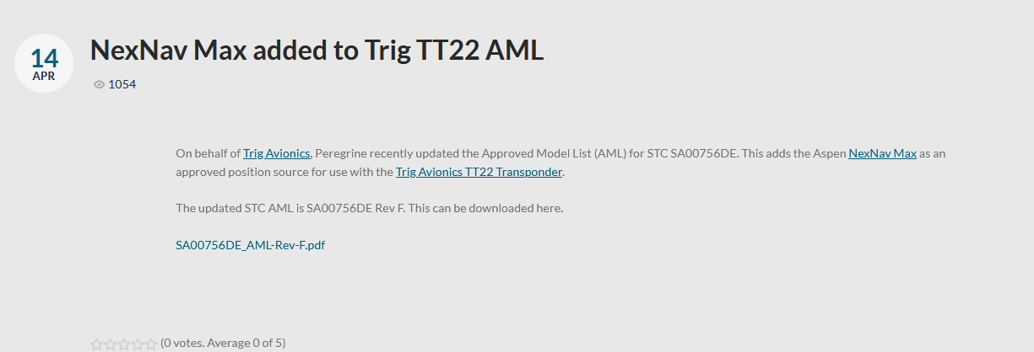

Slide 12
NexNav Max added to Trig TT22 AML
On behalf of Trig Avionics, Peregrine recently updated the Approved Model List (AML) for STC SA00756DE. This adds the Aspen NexNav Max as an approved position source for use with the Trig Avionics TT22 Transponder.
The updated STC AML is SA00756DE Rev F. This can be downloaded here.
SA00756DE_AML-Rev-F.pdf
https://trig-avionics.com/
https://aspennexnav.com/products/?cat=gpssu#max-gpssu
https://www.trig-avionics.com/product/compact-transponder/
https://peregrine.aero/download/12661/?tmstv=1705175231

