Slide 1
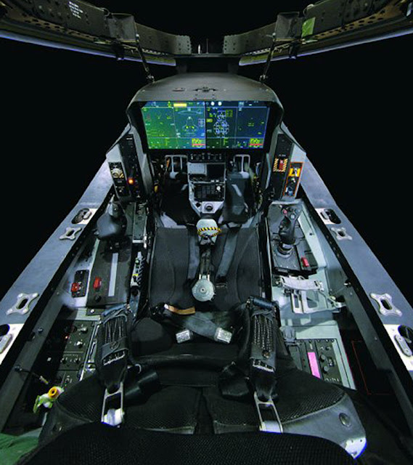
AN OVERVIEW ON
AVIONICS

Slide 2
AVIONICS
Combination of aviation and electronics
Avionics system or Avionics sub-system dependent on
electronics.
Avionics industry- a major multi-billion dollar industry worldwide.
Avionics equipment on a modern military or civil aircraft account for around
  30% of the total cost of the aircraft
  40% in the case of a maritime patrol/anti-submarine aircraft (or helicopter)
  Over 75% of the total cost in the case of an airborne early warning aircraft

Slide 3

AVIONIC SYSTEMS ARE ESSENTIAL
To enable the flight crew to carry out the aircraft mission safely and efficiently.
Intercepting a hostile aircraft, attacking a ground target, reconnaissance or maritime patrol (Military Aircraft).

Slide 4
VERY IMPORTANT DRIVERS FOR AVIONICS SYSTEMS ARE
      Increased safety
      Air traffic control requirements
      All weather operation
      Reduction in fuel consumption
      Improved aircraft performance and control and handling and reduction in maintenance costs
* In the military case, the avionics systems are also being driven by a continuing increase in the threats posed by the defensive and offensive capabilities of potential aggressors.

Slide 5
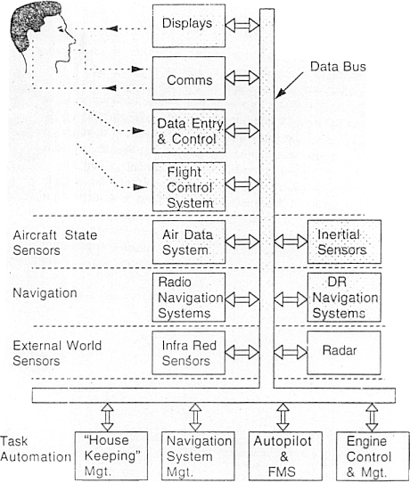
AVIONICS SYSTEMS

Slide 6
AEROSPACE DESIGN INVOLVES
Lot of Analyses
Ground testing and simulation (e.g. wind tunnel tests of model aircraft, flight simulation, drop tests, full scale mock-up, fatigue tests)
Flight tests

Slide 7
Major -Ilities of Avionics System
Capability
Reliability
Maintainability
Certificability
Survivability(military)
Availability
Susceptibility
vulnerability
Life cycle cost(military) or cost of ownership(civil)
Technical risk
Weight & power

Slide 8
Capability:
  How capable is avionics system?
  can they do the job and even more?
  Designer to maximize the capability of the system within the constraints that are imposed.
Reliability:
  Designer strives to make systems as reliable as possible.
  High reliability less maintenance costs.
  If less reliable customer will not buy it and in terms of civil airlines the certificating agencies will not certify it.

Slide 9
Maintainability:
  Closely related to reliability
  System must need preventive or corrective maintenance.
  System can be maintained through built in testing, automated troubleshooting and easy access to hardware.
Availability:
  Combination of reliability and maintainability
  Trade of between reliability and maintainability to optimize availability.
  Availability translates into sorties for military aircraft and into revenue flights for civil aircrafts.

Slide 10
Certificability:
  Major area of concern for avionics in civil airlines.
  Certification conducted by the regulatory agencies based on detailed, expert examination of all facets of aircraft design and operation.
  The avionics architecture should be straight forward and easily understandable.
  There should be no sneak circuits and no noobvious modes of operation.
  Avionics certification focus on three analyses: preliminary hazard, fault tree, and FMEA.

Slide 11
Survivability:
  It is a function of susceptibility and vulnerability.
  Susceptibility: measure of probability that an aircraft will be hit by a given threat.
  Vulnerability: measure of the probability that damage will occur if there is a hit by the threat
  Life cycle cost(LCC)or Cost of ownership:
    It deals with economic measures need for evaluating avionics architecture.
    It includes costs of varied items as spares acquisition, transportation, storage and training (crew and Maintenance personnel's),hardware development and test, depreciation and interest.

Slide 12
Risk:
  Amount of failures and drawbacks in the design and implementation.
  Over come by using the latest technology and fail proof technique to overcome both developmental and long term technological risks.
Weight and power:
  Minimize the weight and power requirements are two fundamental concepts of avionics design.
  So the design must be light weight and power consuming which is possible through the data bus and latest advancement of electronics devices.

Slide 13
Integrated Avionics weapon systems
SONAR
RADAR
Military communications
Electro optics (FLIR or PIDS)
ECM OR ECCM
ESM/DAS
Tactical missile guidance

Slide 14
AVIONICS SYSTEM ARCHITECTURE
Establishing the basic architecture is the first and
the most fundamental challenge faced by the
designer
The architecture must conform to the overall aircraft
mission and design while ensuring that the avionics
system meets its performance requirements
These architectures rely on the data buses for intra
and intersystem communications
The optimum architecture can only be selected
after a series of exhaustive design tradeoffs that
address the evaluation factors

Slide 15
AVIONICS ARCHITECTURE
First Generation Architecture ( 1940’s –1950’s)
      Disjoint or Independent Architecture ( MiG-21)
      Centralized Architecture (F-111)
Second Generation Architecture ( 1960’s –1970’s)
      Federated Architecture (F-16 A/B)
      Distributed Architecture (DAIS)
      Hierarchical Architecture (F-16 C/D, EAP)
Third Generation Architecture ( 1980’s –1990’s)
      Pave Pillar Architecture ( F-22)
Fourth Generation Architecture (Post 2005)
      Pave Pace Architecture- JSF
      Open System Architecture

Slide 16
Head-up Display (HUD)
HUD uses high brightness CRT
HUD projects some of the information normally on the primary flight displays and selected systems or weapons data into the LOS of the pilot without substantially dimming or obscuring the outer view
HUD allows the pilot to simultaneously see critical aircraft information while viewing the outside scene

Slide 17
HUD…
High performance aircraft HUDs use one of two basic designs for the combiner:-
  Single element combiner HUD
  Three element combiner HUD

Slide 18
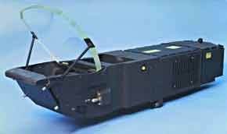
A typical HUD

Slide 19
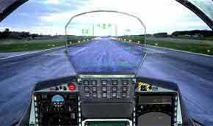
HUD in Cockpit

Slide 20
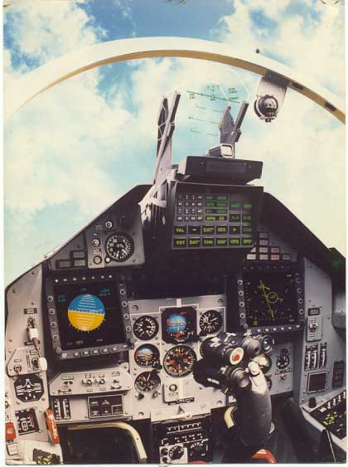

Slide 21
Head Level Display (HLD)
HLDs are another option for cockpit displays
HLD avoids physiological limitation on eye refocusing time (as high as 200ms) by placing directly below the HUD or top edge of the instrument panel display in which an image and supplement alphanumeric information are focused at a long distance, say about 50 m
Thus the need for the pilot to refocus his eyes to scan at least some information inside the cockpit is eliminated

Slide 22
HLD…
Normally HLD is used to display Radar or IR images or digital map
HLD uses high intensity lamp coupled with dichronic filters to sort the white light into red, green and blue

Slide 23
Helmet Mounted Display (HMD)
HMD
  High brightness
  Excellent Resolution
  Lightweight
  Small size
  Monochrome
HMD is advantageous over HUD
Critical aircraft & stores information in in pilot’s LOS at all times, not just when he is looking straight ahead

Slide 24
HMD…
HMD display format are similar to HUD format
Design of HMD, factors to be considered are
  Weight: Helmets are designed using light weight materials
  Helmet Aerodynamics: Helmets are not designed for aerodynamics because during ejection, if designed for aerodynamics then it pulls the pilot’s neck upwards
HMD is also used by Maintenance Personnel to have hands free and eyes fixed on the repair task at hand simultaneously viewing maintenance drawings and procedures

Slide 25
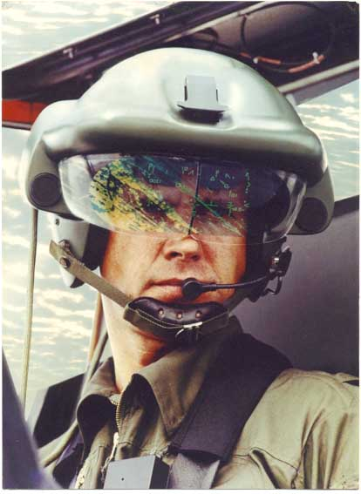
Figure showing HMD

Slide 26
Night Vision Goggles (NVG)
Night-vision goggles are electronic widgets that allow you to see things at night when it is too dark to see things with just your eyes alone
Two type of Night Vision Imaging System (NVIS)
  Type I
    Uses only Binocular goggle with phosphor screen image
    Used generally in rotorcraft
  Type II
    Have same goggle as Type I, but provision has been made to allow the pilot to directly view the instruments through a combiner positioned below the goggle
    Commonly used in fixed wing aircraft

Slide 27
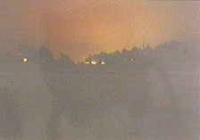
Surveillance photo taken without NVG

Slide 28
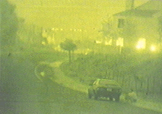
Surveillance photo taken using NVG

Slide 29
AIRCRAFT’S MOTION SENSOR
Rate gyroscopes : Rate of rotation about roll,pitch and yaw axes.
Linear accelerometers : Normal and Lateral acceleration.
Air data sensors : Height and Airspeed.
Airstream sensors : Incidence angles in longitudinal and lateral planes.

Slide 30
GPS

Slide 31
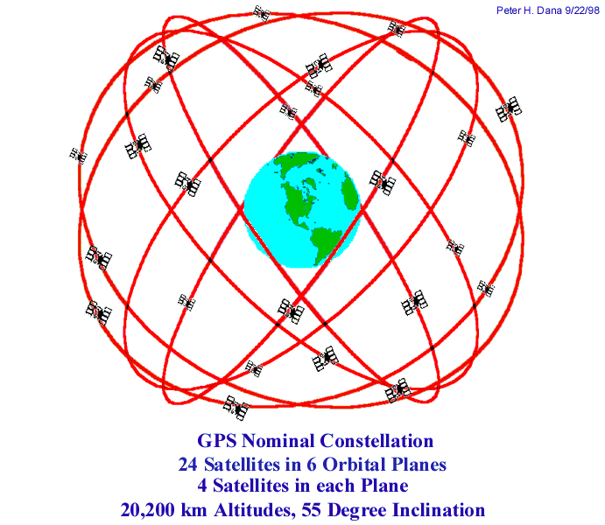

Slide 32
Why to go for satellite Navigation?
Satisfy as large a range of users as possible, military as well as civilian
Relatively low user cost as well as ease-of-operation
Unrestricted access by all users
Satisfy military positioning requirements

Slide 33
Inertial Navigation system
It is a type of dead Reckoning system.
It is the self contained , autonomous and unjammable.
It measures linear motion and rotations using accelerometers and gyroscopes.
From the initial navigation data obtained from the other navigation system or user, the navigation computer gives the attitude , position and velocity.
It is faster than the data given by the GPS.
INS is very accurate over the short distance.
It is of two different configuration based on the Inertial sensor placement. They are
a. Stable or Gimballed platform.
b. Strap down platform

Slide 34
Stable or Gimballed Platform system:
In which the Accelerometer and gyro are placed in the stable platform which is maintained stable by the gimbal system. Then the acceleration measured in the inertial coordinates
Strap down Platform:
In this system the accelerometers are mounted on the vehicle platform and are therefore fixed to the vehicle coordinate system. The acceleration measured are then in vehicle coordinates
Advantage and Disadvantage of Stable platform:-
    It is very reliable, accurate and value for the money.
    The mechanical gimbal arrangement is very complex.
    Expensive and replacing , rebuild are very lengthy process
    Calibrations are very lengthy process

Slide 35
THANK YOU
PRESENTED BY:-
SAI SHUBHANKAR
Notes:
PRESENTED BY:-SAI SHUBHANKAR AISST ROLL-6

