Slide 1
Peregrine Web Traffic Increase Strategy

Slide 2
Why has new traffic dropped off
“Ah, looks like this is stuff I already know; no need to bother with the website”
“Hmmm… nothing has changed on the website. No need to dig further”

Slide 3

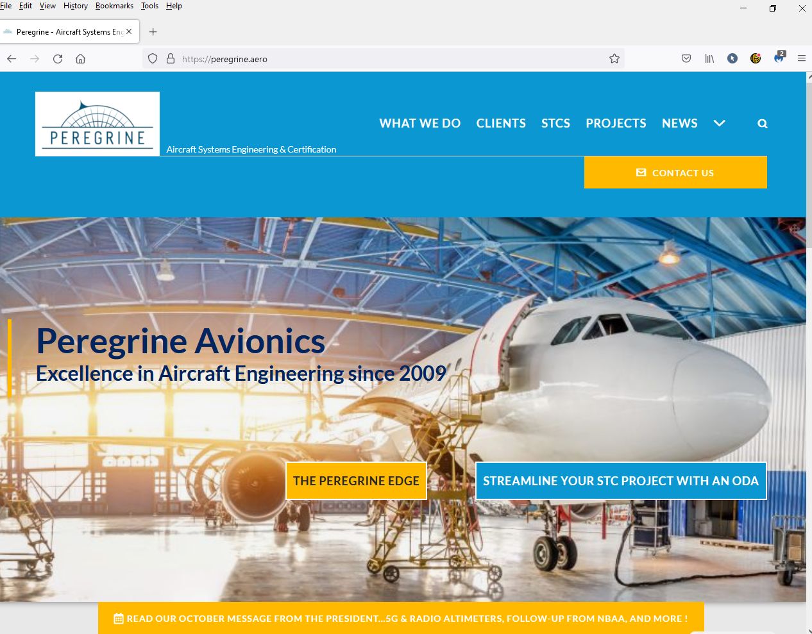

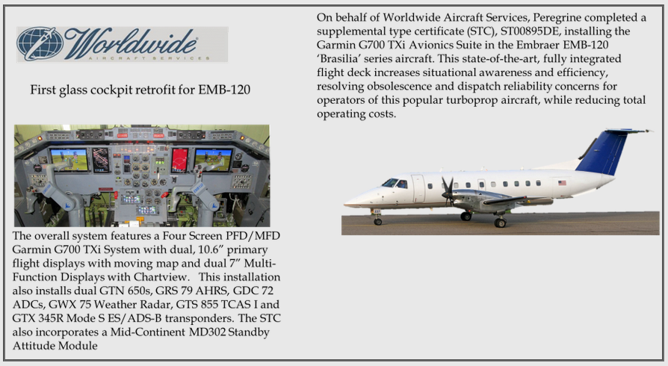
Create a reason to visit!
Featured Project
Video describing project
“Peregrine Completes 30th STC project”
- Come see a review of our featured projects!

Slide 4
Create a reason to visit!
ODA does this
Yeah! ODA!!!
ODA saves you BIG BUCKS
“Peregrine Receives ODA”

Slide 5
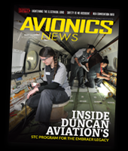
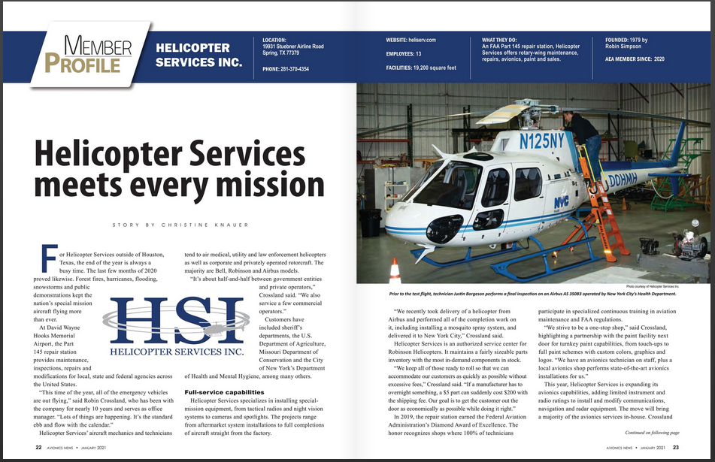

Create a reason to visit!
ODA does this
Yeah! ODA!!!
Featured Project
ODA saves you BIG BUCKS
Peregrine ODA!
“Peregrine Member Feature”
Peregrine ODA!
Feature article

Slide 6

Capture emails when downloading STCs
“Before you download the link, please share your email so we can keep you up to date!”
Enter your email
Nope…

Slide 7
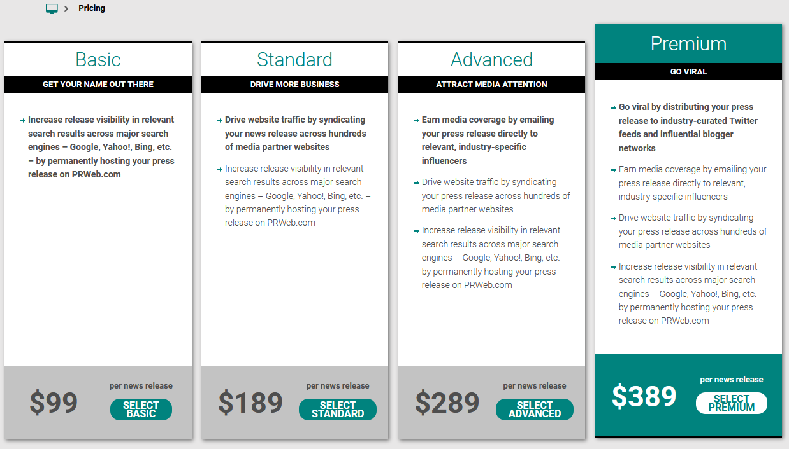
PRWeb
$X
2 $X
3 $X
4 $X

Slide 8



Slide 9


Slide 10


