Slide 1
Add Testimonials and PRs
Forrest: New AGG website
Post new PRs and Testimonials
Pointers to Trig
Lee: Press Releases
CW CVR white paper?
Hal: ACA white paper?
Forrest: Move
Lee: Press Releases:
- Hawker 4000
- CW CVR
- New message from Dave
- Vacation 4/23 – 5/1
Hal: Testimonial harvest
ACA link
Links to PA: Talon Air*
ACA
Mountain air*
Finnoff*
Mid-co*
CW*
gogo AVANCE L3*
Western*
Lee Aerospace*
Gulfstream
Trig*
* lee
Forrest: Add brochure pages to AGG website
AEA rollout?
Peregrine-centered activity

Slide 2
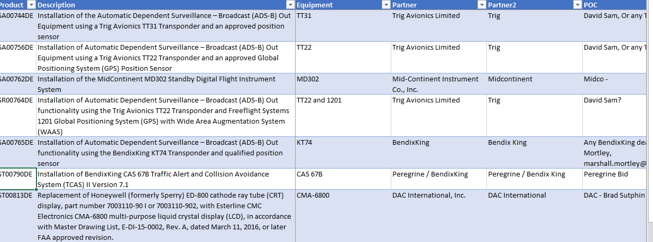
$AviaGlobalGroup\Client Info\Peregrine\200830 - Peregrine STC Cheat Sheet.xlsx
Create links to STC owners and quoters on Peregrine website

