Slide 1
Initial G150 Heater STC Chase & Capture
Challenges
Discovery
Execution Plan/ Plan

Slide 2
G150 Heater STC Challenges
Challenges of finding the actual operator and decision maker
Identify people who are buying influences
Economic Buyer = yes/no/veto
User
Technical
Competition is “DO NOTHING”

Slide 3
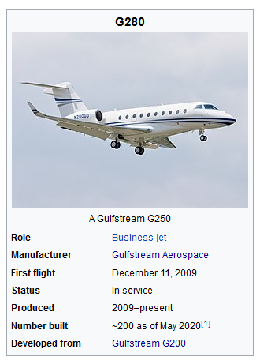
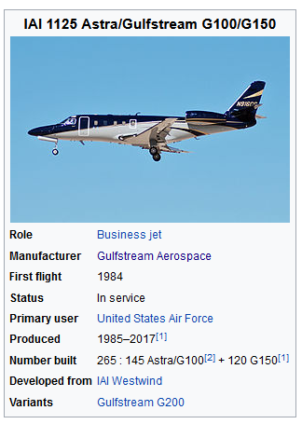
Initial G150 Heater STC Action Planning
Discovery Understanding – Peregrine Collaboration: (HA WIP)
Secure details & share in AGG
Pricing and structure of the STC
Details of the heater STC and high level pro/ con expectations
G1/200/2(5)80 with same issues? No STC even if problem? Opportunity? Gulfstream?
S.S. White Flexible Rotary Shafts Drive Flap And Slat Actuation Systems On The Gulfstream G150 and G200 Business Jets
Discovery Research (LC – WIP)
Compiled list of G-150 serial number
Correlated serial numbers with registration data
Data mining operators WIP (~10% done)
Reviewing, refining target list and contact info
Existing, new data gathering , etc., as needed.
Target aircraft in US and Canada first (100 airframes)

Slide 4
Initial G150 Heater STC Action Planning
G150 Countries of Registration/ Quantity
USA | 90
Canada | 10
Mexico | 5
Australia | 3
Brazil | 3
Chile | 2
Philippines | 2
Austria | 1
Cayman Islands | 1
India | 1
Isle of Man | 1
Malta | 1
Poland | 1
Turkey | 1
Venezuela | 1
Initial Opportunities Priority
Primary USA, Canada
Secondary (?)
Tertiary/ Unlikely

Slide 5
Initial G150 Heater STC Action Plan
Initial Execute Plan/ Plan (Chase & Capture)
Primary = Engage direct PERSON<>PERSON influencers
Follow up with calls based on Mailchimp responses
Continuous process until all opportunities processed
Secondary = Indirect contacts via targeted email, trade shows (AEA)
Mailchimp – to operators, owners, shops that work on G150s
Indirect contact - web site, snail mail, trade shows (Peregrine AEA booth handouts, media blasts/ press release)
Snail mail follow up to operators, owners, shops that work on G150s
Develop collateral marketing items to support AEA (others), direct mail
Media advertising opportunities?? NBAA, Gulfstream owners orgs (none found in web search)
Simultaneous primary & secondary actions … continuous refinement process
Communication process - who is Peregrine POC for processing STC RFQ and purchases
Other actions ... WIP/ TBD
Timing of status reports? Weekly until determined otherwise?
Feedback re G1/200 series comprehensive heater STC?

