Slide 1


G150 Heater Solution
Peregrine has developed an approved solution to a issues with the G150 flap and slat actuation systems that may arise during approach and landing in certain situations.
When a G150 has been exposed to precipitation or high humidity, exposure to freezing temperature at altitude can cause the flap and slat actuation drives to freeze, preventing the high lift devices from deploying properly. This situation can lead to:
High speed landings and shallow approached without flaps or slat deployment
Costly diversion to another destination with a runway of suitable length from a higher than normal landing speeds
Mailing address
Mailing address
Mailing address
Return address
Return address
Return address
Unexpected long landings in your G150?

Slide 2

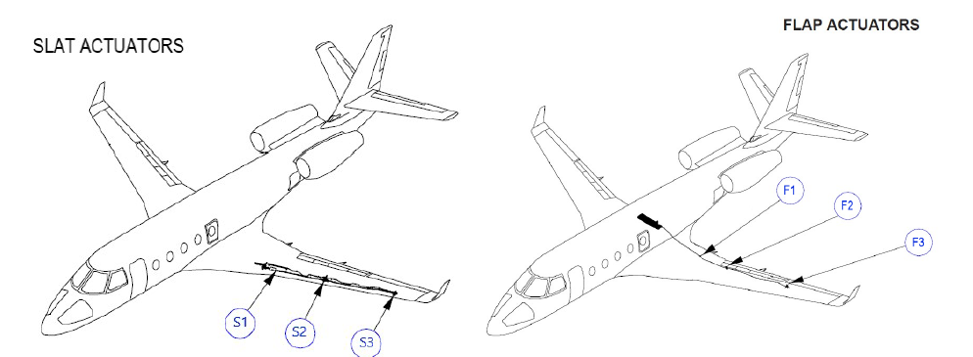
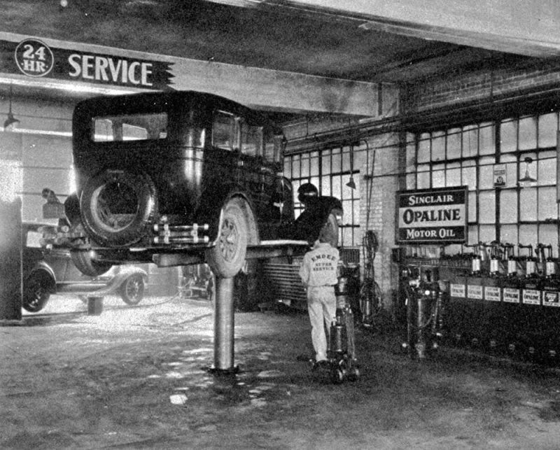
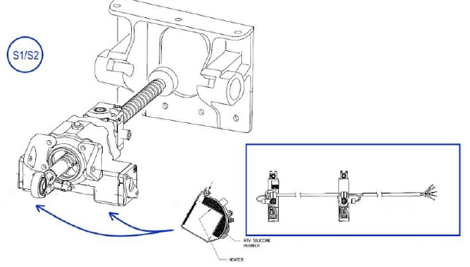

Solution Pedigree
STC Details
STC Availability and Details
The STC involves the fitting of heater components to each of the twelve (12) actuator devices, installation of the control module and cockpit switch/annunciator installation.
The STC and associated components are available directly from Peregrine.
Peregrine also offers a ‘turnkey’ solution including labor, STC and project management for complete installation and return to service of your G150 at our selected Englewood, Colorado, authorized Part 145 repair station
Gulfstream operates several ‘Gulfstream Field and Airborne Support Teams (FAST)’ G150 aircraft to provide factory service for customers.
The FAST G150 aircraft encountered this flap/slat actuation issue and worked with Peregrine and an authorized repair facility to develop a retrofit solution.
Peregrine answered the challenge and developed a complete STC solution that has subsequently been installed on the FAST aircraft
While not a Service Bulletin from Gulfstream, the STC has been recognized by Gulfstream FAST operation as solving the issue with high lift actuation system freeze-up.
STC does not modify the G150 Flap/Slat drive system including controls, indications, safety mechanisms or recommended lubrication maintenance procedures
Straight Flight, located at Centennial Airport (KAPA), south of downtown Denver, Colorado. Air Agency Certificate #OMKR399L
Wrap-around, cuff-style, design and are mounted on the exterior of the actuators
LOGO
Peregrine
Englewood…
The process requires approximately three (3) weeks of downtime and a six (6) week lead time.

Slide 3
G150 Heater Solution
Solution Pedigree
STC Availability and Details
Peregrine has developed an approved solution to a issues with the G150 flap and slat actuation systems that may arise during approach and landing i certain situations.
Gulfstream operates several ‘Gulfstream Field and Airborne Support Teams (FAST)’ G150 aircraft to provide factory service for customers.
The FAST G150 aircraft encountered this flap/slat actuation issue and worked with Peregrine and an authorized repair facility to develop a retrofit solution.
Peregrine answered the challenge and developed a complete STC solution that has subsequently been installed on the FAST aircraft
While not a Service Bulletin from Gulfstream, the STC has been recognized by Gulfstream FAST operation as solving the issue with high lift actuation system freeze-up.
The STC and associated components are available directly from Peregrine.
Peregrine also offers a ‘turnkey’ solution including labor, STC and project management for complete installation and return to service of your G150 at our selected Englewood, Colorado, authorized Part 145 repair station
When a G150 has been exposed to precipitation or high humidity, exposure to freezing temperature at altitude can cause the flap and slat actuation drives to freeze, preventing the high lift devices from deploying properly. This situation can lead to:
High speed landings and shallow approached without flaps or slat deployment
Diversion to another destination with a runway of suitable length from a higher than normal landing speeds
The STC involves the fitting of heater components to each of the twelve (12) actuator devices, installation of the control module and cockpit switch/annunciator installation.
The process requires approximately three (3) weeks of downtime and a six (6) week lead time.

Slide 4
Authorized Facility
Solution Pricing
For More Information
Peregrine offers a turnkey solution at our authorized Part 145 repair station partner
STC + installation kit
$XXX,XXX
Six (6) week lead time
42% deposit
$YY,YYY
Peregrine will provide complete STC package, right to use license, installation material, supplemental installation documentation
Turnkey installation
$XXX,XXX
Six (6) week lead time
42% deposit
$YY,YYY
Includes 200 hours labor
Peregrine will provide complete installation and oversight and project management.
(provisor for unexpected repairs and findings)
Straight Flight, located at Centennial Airport (KAPA), south of downtown Denver, Colorado. Air Agency Certificate #OMKR399L

