Slide 1

Peregrine Business Plan
Avionics Installation Designs and Approvals:
From the Drawing Board to the Sky

Slide 2
Business Plan Overview
Peregrine Profile
Target Market Discussion
Competition
Strategy & Planning
Financials Outlook
Appendix

Slide 3
Peregrine Profile

Slide 4
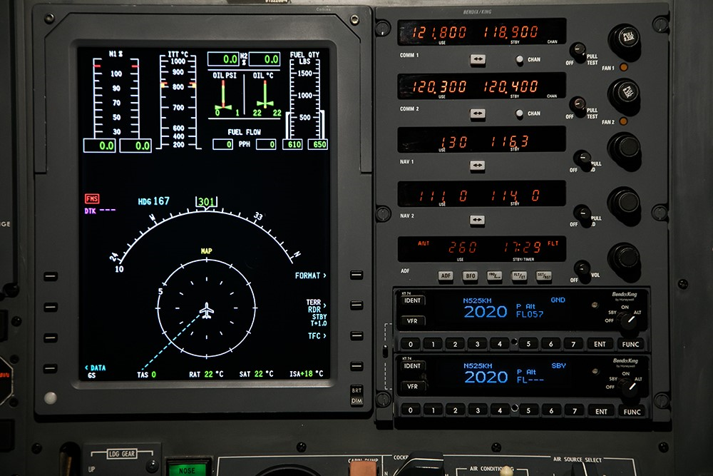



Our Mission
Provide end-to-end FAA-approved STC solutions for our customer/partner network using trusted avionics equipment and proven FAA certification methods
Peregrine
FAA STC Approval
Customer/ Partner Network
Trusted Avionics
Installing new avionics in existing airframes
  An STC (Supplemental Type Certificate) is an FAA-approved design change that supports alteration of an aircraft for the purpose of improving safety, functionality, performance, or maintainability

Slide 5
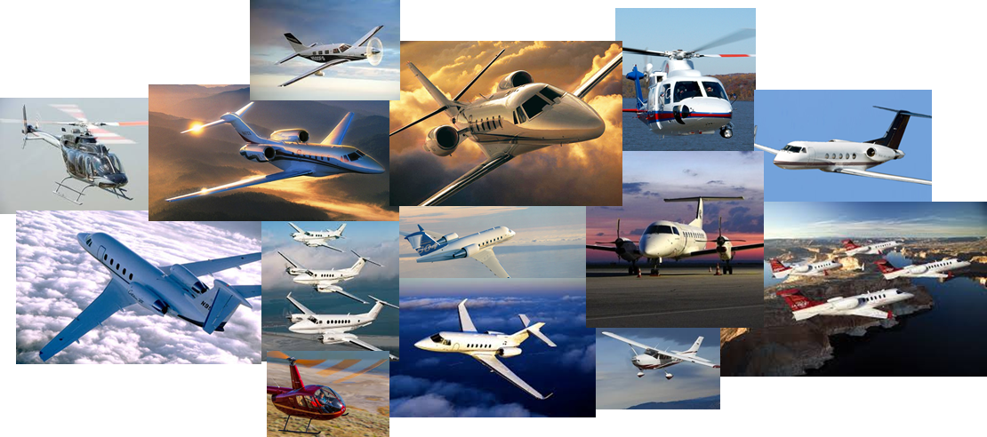
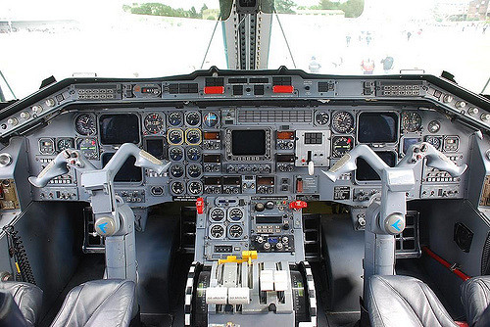
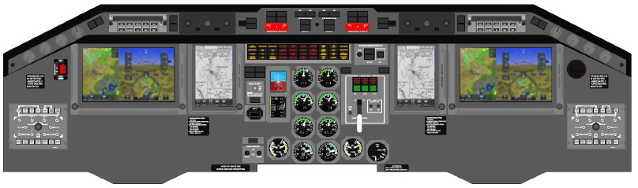
Peregrine Certification Experience
Many aircraft:
Many systems:
Flight deck updates
Attitude Heading Reference Systems (AHRS)
FANS 1/A system
ADS-B OUT system
ADS-B IN system
TCAS II system upgrades
TCAS II compatible Mode S
Flight data recorders
VHF COM radio
Parts obsolescence solutions
Replacing old avionics with modern systems

Slide 6
Peregrine has shown Strong Financial Performance
Past Performance
Focus: Consulting &
STC development
Recent Performance
Focus: Turn-Key STC solutions
Lear 85 consulting
30% of revenue
2018 numbers are unaudited estimates, but believed to be very close. Final 2018 results to be provided separately.

Slide 7
Target Market Discussion

Slide 8
Avionics Market Characterization

Military Aviation
$$$$$
Business Aviation
Platform
Counts
Avionics Unit Margins
Commercial Airlines

General Aviation
$$
Generally, as size of segment platforms decrease, the unit margins increase, and engineering services tend to follow this same model
Peregrine focuses on the Business Aviation market where fleet count is moderate, margins are high and upgrade decisions are driven by commercial needs, not discretionary spending

Slide 9
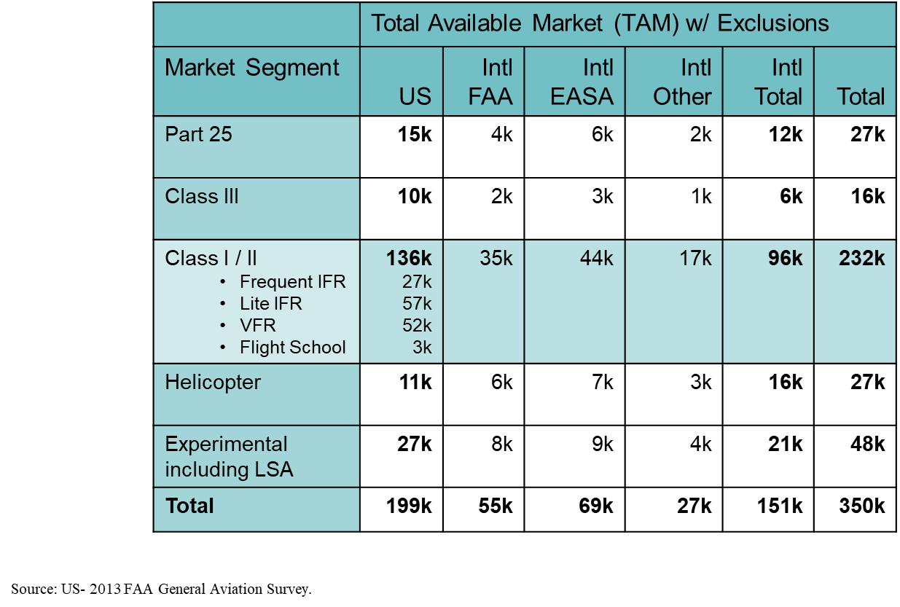
Market Segmentation
Total Aircraft Fleets
Peregrine Target Market
About 48,000
Fixed Wing &Helicopters
Peregrine Target Market
About 31,000
Fixed Wing Aircraft
Peregrine Target Market
About 17,000 Helicopters
Total FAA
Registered
254,000
Aircraft

Slide 10

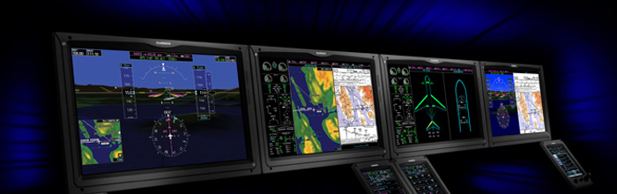
Avionics Engineering Services: a Growth Market
Business & General Aviation retrofits exceed $1.5B/yr., growing at 15%
Older airframes are economically viable, thus retrofitted, not retired
Industry trends indicate continued strong growth:
  New products in high demand (airborne WiFi)
  Regulatory requirements (ADS-B, FANS, NextGen)
  Parts obsolescence solutions (OEM fleet support)

Slide 11
Competition

Slide 12
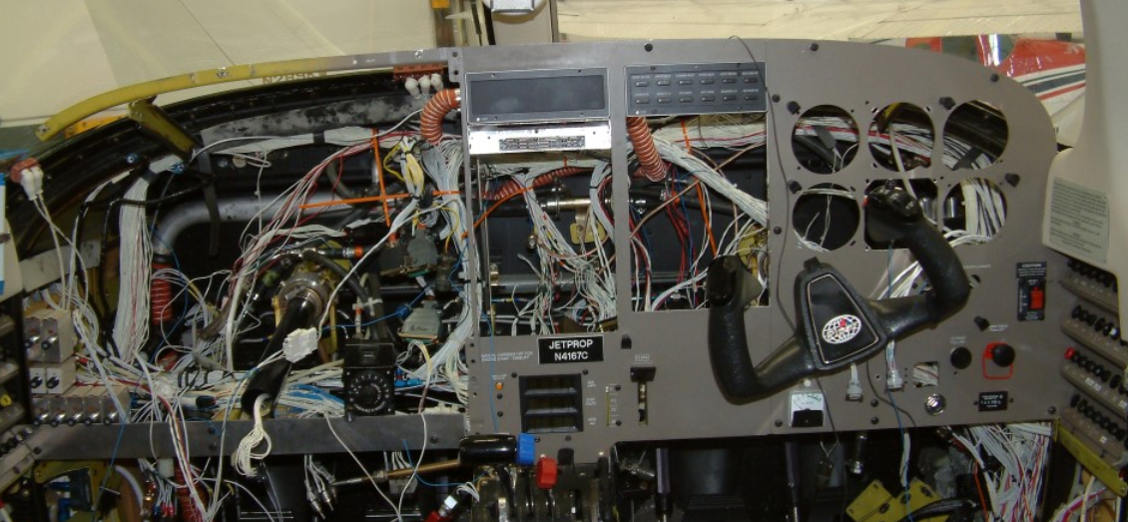
Competitive Analysis
Aircraft OEM’s focus on forward fit, not retrofit
Avionics manufacturers often resource constrained due to primary focus on component level development
Significant opportunity for 3rd party STC development
Major competitors include 3S, Duncan, Stevens, Elliott and West Star
Peregrine has advantage in price (lower cost structure), speed and quality

Slide 13
Key Competitive Factors
Providers of Avionics Engineering and Certification Services compete on these bases, in priority order:
Quality of the STC
Speed of obtaining the STC
Ability to hit program schedule and budget
Price
OPEN ITEM – 28FEB19
Note: placement of competitors on this matrix is made up simply for demonstration purposes; BOA input needed to determine true relative positions of each firm
Competitor Matrix
Peregrine - now
Peregrine - future
High
Envoy
Duncan
3S
Quality
Elliott
Stevens
West Star
Low
Low
Speed
High

Slide 14
Peregrine Value Proposition
Leading provider of avionics solutions
  Strong identification among network partners, trusted avionics team
Major opportunities to accelerate growth
  FAA NextGen & ROW modernization will continue to drive retrofit business
  FANS, flight deck updates, etccccccccccccccc.
Intellectual property
Highly scalable business model
  STCs generate high contribution margins and ongoing revenue opportunities
  Infrastructure established
  Requires investment to support significantly higher levels of revenue
Strong, experienced management team and focused BOA
For reference only
SWOT basis???

Slide 15
Strategy & Planning

Slide 16
Five Year Goals
In 2023 we will have:
At least $10m in Revenue (50% growth per year)
At least $1.5m in Net Income
A reputation as the finest STC Engineering and Certification firm in the industry, and be “top of mind” of firms seeking avionics STC’s in our target segments.

Slide 17
Our Institutional Knowledge Provides us with rare expertise in the Complex FAA STC Process
Project lengths influenced by many factors

Slide 18
Strategy Statement
Peregrine will grow its business by leveraging its STC brand and expertise through:
Adding Part 145 Repair Station capability
Adding ODA capability
Expanding PMA operations
Expanding Marketing actions
These actions will allow Peregrine to:
Increase project speed
Decrease project cost
Decrease project schedule risk
Maintain its sterling reputation for quality

Slide 19
4 Pillar Growth Strategy
Accelerate marketing & business development activities.
Seek out potential industry partnerships and cooperative ventures.
Explore new markets.
Add ODA function & leverage FAA relationships.
Add Part 145 First Installation capability
Build associated PMA business
Focus on STC ownership/royalty rights (recurring revenue).
Deemphasize contract engineering.
Continue building reputation for unmatched quality & dependability.
Manage to insure profitable growth.

Slide 20
Tactics for Pillar #1
Continue building reputation for unmatched quality & dependability.
Manage to insure profitable growth.
Rigorous internal standards for work product.
Close technical supervision.
Highest quality team members.
Engagement of experienced executive skills (e.g., Board of Advisors).

Slide 21
Tactics for Pillar #2
Focus on STC ownership/royalty rights (recurring revenue).
Deemphasize contract engineering.
Presently resetting our criteria for job selection and negotiation of terms.

Slide 22
Tactics for Pillar #3
Add ODA function & leverage FAA relationships.
Add Part 145 First Installation capability
Build associated PMA business
Program plan for addition of ODA function in 2019.
Plans to add Part 145 in 2020 or sooner.

Slide 23
Tactics for Pillar #4
Accelerate marketing & business development activities.
Seek out potential industry partnerships and cooperative ventures.
Explore new markets.
Comprehensive marketing strategy in work.
Currently assessing inquiries regarding cooperative opportunities.
Grow both organically and by acquisition
Evaluating requests for bids on Unmanned Aerial Systems work.

Slide 24
2019 & 2020 Initiatives: Add ODA and Part 145 First Installation Capabilities
Key success factors in STC market are speed & predictability:
Accomplish design and certification projects in short time frames
Complete them as committed, without delays
Presently, Peregrine outsources its ODA and First installations:
Contracted parties may have other and changing priorities
Contracted parties’ delays force inefficient juggling of Peregrine resources
Charges to Peregrine include margins for the contracting parties
Solution: Peregrine to have in-house ODA and Part 145:
Shorten overall project flow times
Control performance to project schedules
Avoid inefficient juggling of Peregrine resources and keep contractor margin

Slide 25
Program Plan: Obtain ODA Capability
Expect 12-15 months to complete.
Budgeting approx. $250k for ODA startup:
  ODA Consultant – write manuals & train.
  Initial ODA administrator.
  Miscellaneous costs.
Detailed plan in work by Board of Advisors member who is a former ODA administrator.

Slide 26
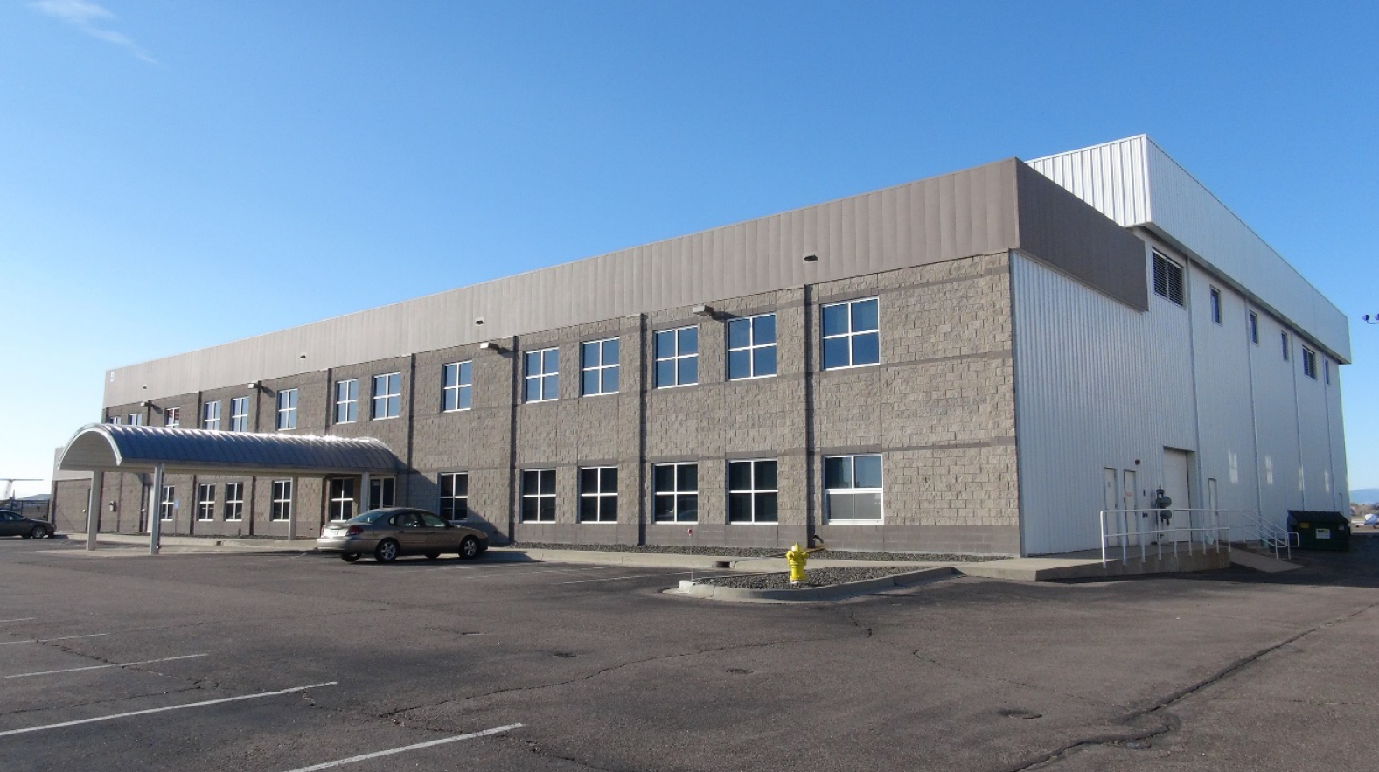
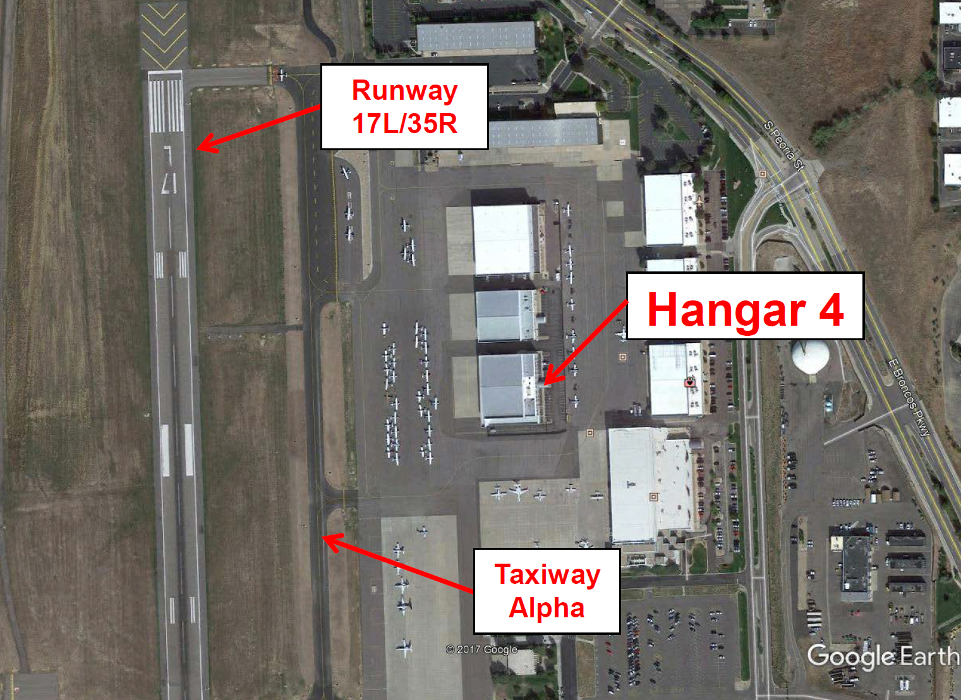
Excellent Facilities with Expansion Potential
Denver, Colorado Metropolitan Area
Centennial Airport (APA)
Peregrine
7385 S Peoria Road
Englewood, CO 80112
+1-303-325-3873
www.peregrine.aero
Centennial Airport
Leased offices in Hangar 4 at TACAir, east side of Centennial Airport (SE Denver area)
Engineering, admin offices and shop space totaling 3,250 sq. ft.
Growth
Ability to expand into hangar space within same building
Denver metropolitan area has large, diverse aerospace business & labor base
  The United States Census Bureau estimates that the population was 2,888,227 as of July 1, 2017, an increase of +13.55% since the 2010 United States Census, and ranking as the 19th most populous metropolitan statistical area of the United States
  http://www.metrodenver.org/industries/aerospace/

Slide 27
Skilled and Experienced Team
David Rankin
President
Electrical DER
Jeff Kistler
Senior Engineer Company DER
Cory Smith
Electrical Engineer
Jennie Alfs
Controller
David Sam
Quality Control
Neil Schroeder
Engineering Avionics Technician
Bobby Childers
Lead CAD Designer
Tiffany Hiler
Marketing/Business Development
Lee Carlson
Product Support
Daniel Mazin
Deign Engineer
Kevin Gould
Board of Advisors
Business
Bill Shields
Board of Advisors
Regulatory
Hal Adams
Board of Advisors
Technical
More details in Supplemental Information

Slide 28
David Rankin, CEO
Peregrine Avionics 2009 - present
  Founder, President and Electrical Systems DER.
  Led development of 20 STC’s covering Parts 23, 25, 27 and 29 aircraft including Gulfstream, Challenger, Falcon, Hawker, Lear, Sikorsky, Piper, Beechcraft, Bell, Robinson, MD Helicopters, Airbus Helicopters, Augusta, Cessna, Citation Jet, and several AML’s.
  Grew company to 10 employees and $1.3m in revenue.
Adam Aircraft Industries 2001 - 2009
  Director of Systems Engineering: Led 25 engineers and designers to develop electrical and avionics systems included in the Type Certificate for the A500 aircraft in conjunction with both the Denver and Chicago ACO’s.
  FAA Designated Engineering Representative for electrical systems on the A500 aircraft.
  Electrical Systems Manager for systems on A500 and A700 models; supported flight test.
US Air Force 1995 - 2001
  Officer, Development Engineer, Defense Contract Management Agency - Lockheed Martin Astronautics
  Officer, Development Engineer, Electronic Combat Support Flight - Special Operations Command
Education
  Georgia College & State University – Masters of Business Administration, 1998
  United States Air Force Academy – Bachelors of Science in Electrical Engineering, 1995

Slide 29
Peregrine Board of Advisors
Hal Adams – technical expertise
  Founder and former COO of Accord Technology
  Expertise in GPS, ADS-B, CNS, INS, FMS and other avionics technologies
  40 years experience in aerospace including Northwest Airlines, Lockheed-Martin, Northrop Grumman, Rockwell Collins, Thales Aerospace
Bill Shields – certification expertise
  Founder and former ODA administrator at 3S Certification and 3S Engineering
  Expertise in FAA certification processes
  37 years experience in aerospace including Hawker Beechcraft, ARINC, S-Tec, Gulfstream, Collins Avionics and Continental Radio
Kevin Gould – business expertise
  Former CEO of Piper Aircraft; former President of Bendix/King
  Expertise in business leadership, financial management and capital structuring
  30 years experience in aerospace including Boeing, Piper Aircraft, Honeywell, Bendix/King, Adam Aircraft and Eclipse Aerospace

Slide 30
Financial Outlook

Slide 31
Peregrine Generates Revenue 4 Ways:
Turn-Key STCs (fixed-price design & cert; 52%):
Development and FAA approval of complete STCs for avionics manufacturers, distributors, repair stations
(Trig Avionics, DAC International, Southeast Aerospace)
STC Kits (hardware sales on spent NRE; 33%):
Revenue generated from sales of Peregrine produced aircraft hardware kits that facilitate the aircraft alterations per Peregrine STCs
(Cessna 525 radio rack panels, airspeed switch kits)
STC Licensing (royalties on spent NRE; 11%):
Recurring revenue generated from the licensing of Peregrine owned STCs for use on specific aircraft
(TCAS II upgrades, Rotorcraft ADS-B Out)
Consulting Revenue (hourly rate; 5%):
Ongoing engineering support of FAA certification projects for equipment manufacturers
(BendixKing, GoGo)
2017 numbers provided for reference. 2018 financial results to be provided separately.

Slide 32
Expense Breakdown
2017 numbers provided for reference. 2018 financial results to be provided separately.

Slide 33
Financial Results – 2018 (Audited?)
Income Statement
Balance Sheet
Backlog/ Projects
2018 Forecast vs. Actual (Other Metrics – ROS?)
  If available

Slide 34
Financial Goals

Slide 35
Financial Outlook/ Projections
Annually FY 2020 through 2025
Operating Income
COGS
Gross Profit
EBITA
EBIT
Profit/ Loss
Metrics – Year over year comparisons
  i.e. Cashflow projections, ROS

Slide 36
Appendix

Slide 37
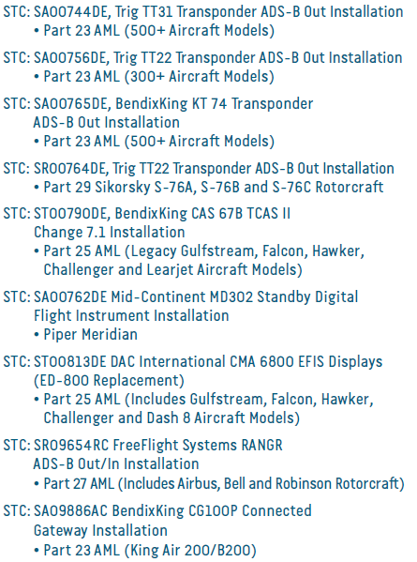
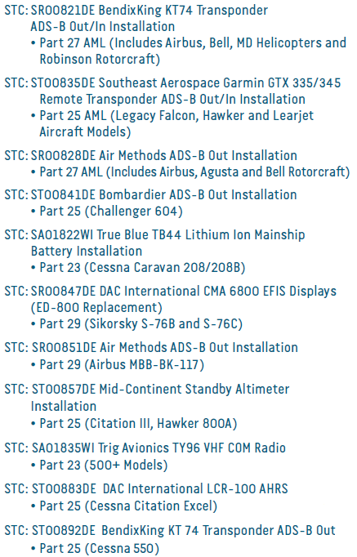
Peregrine Key STC Completions

Slide 38










Peregrine Customer/Partner Network
Peregrine has established itself as a reliable STC resource, trusted by some of the most respected companies in the aviation industry

Slide 39
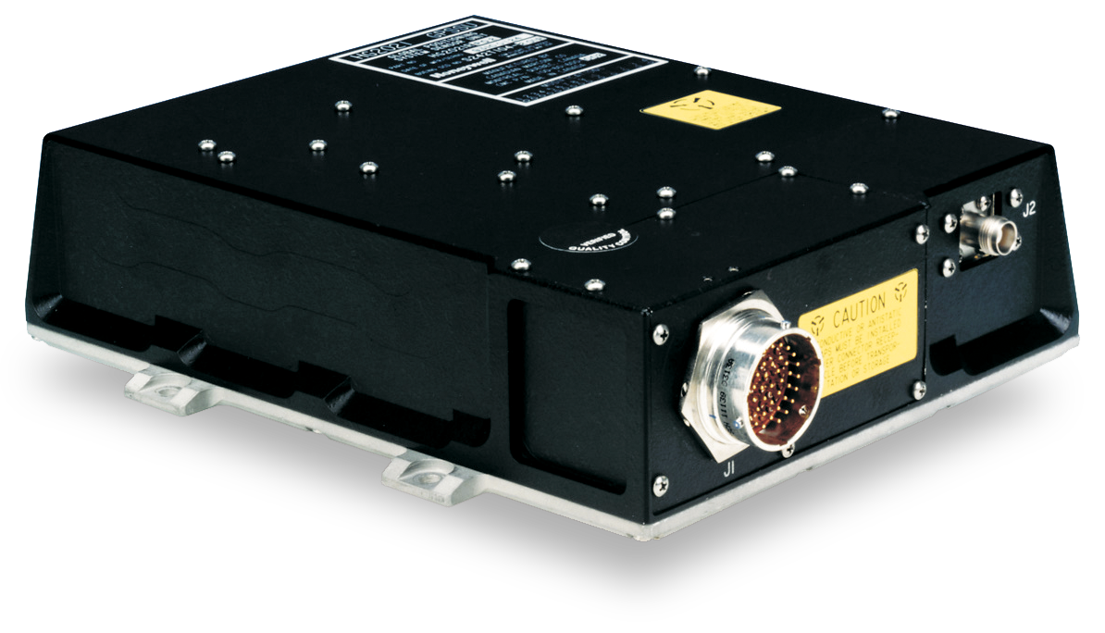
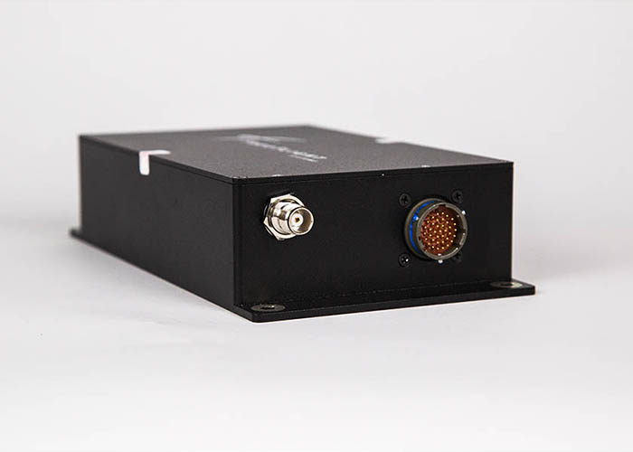
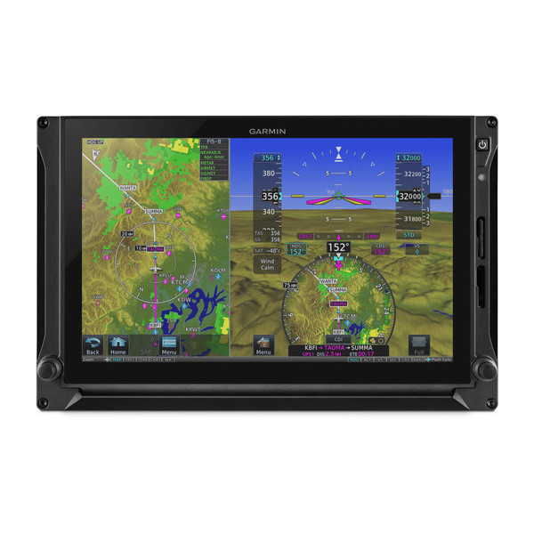

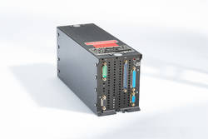

Trusted/Preferred Equipment
Trig Avionics
  ADS-B OUT Mode S Transponders
FreeFlight Systems
  ADS-B OUT/IN UAT Transceivers and GPS WAAS Sensors
Becker Avionics
  ADS-B OUT Mode S Transponders
Garmin Avionics
  ADS-B OUT Mode S and Flight Displays
Mid-Continent Standby Attitude Module
True Blue Power
  Main Ship Lithium Battery
CMC Electronics
  Flight Display and GPS WAAS Sensors
BendixKing
  TCAS II (Traffic Collision Avoidance System)
Northrop Grumman LITEF
  Attitude Reference Heading System

Slide 40
What our Customers say:
“Peregrine has been a big help on short notice in providing engineering support for our Learjet avionics installations. We appreciate their experience and responsiveness.”
James Bohart, Avionics Manager, Trine Aero
“I really appreciate everything that the Peregrine team has done to support our ADS-B Out installations on the Citations. With their STC data and their engineering support, we have been able to install and release aircraft in a timely manner with a quality system installation. Our customers have been very happy with the low down time for installation as well as the exceptional performance of their new system."
Ben Doying, Avionics Department, Eagle Aviation

Slide 41
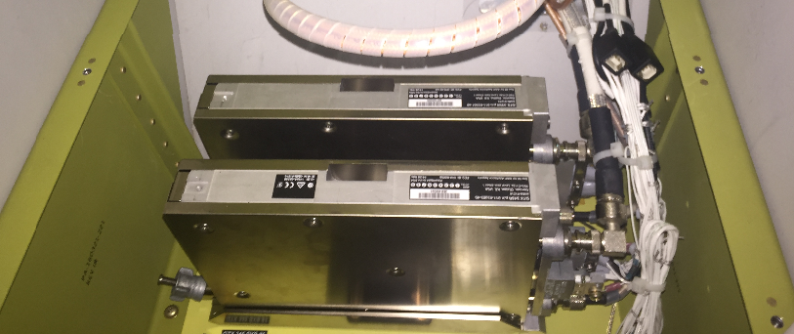
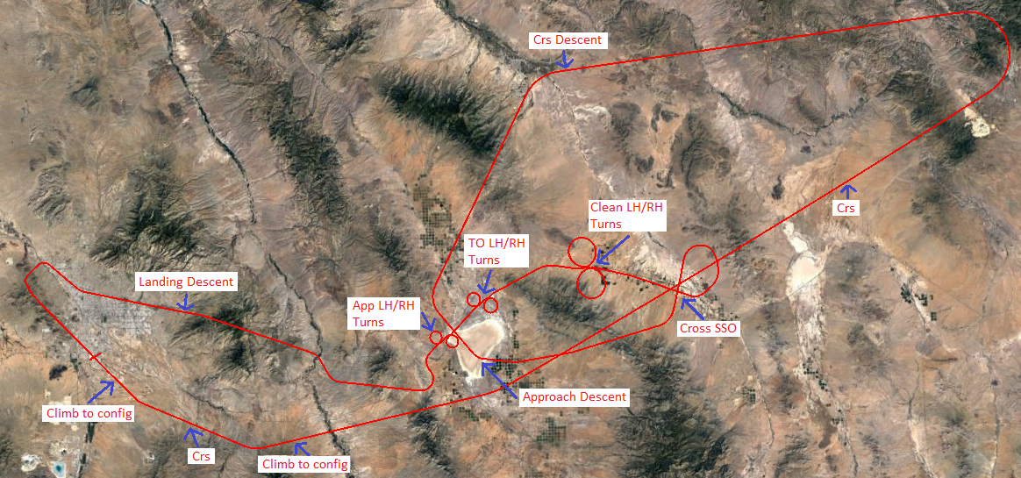
Typical STC Project
Data Package
Initial System Installation
Certification Documents
Document | Description
BAS63022920 | Project Specific Certification Plan
BAS63022921 | Conformity Inspection Plan
BAS63010136 | Master Drawing List
BAS63230215 | System Substantiation
BAS63120222 | Ground Test Procedure
BAS63180177 | Ground Test Report
BAS63110139 | Flight Test Plan
BAS63370031 | Flight Test Report
BAS63050061 | Instructions for Continued Airworthiness
BAS63040223 | Airplane Flight Manual Supplement
BAS63070149 | System Safety Assessment
BAS63130177 | Structural Substantiation
BAS63380025 | Compliance Summary Report
Design Data
Document | Description
BAS63033126 | TDR-94D Transponder Installation
BAS63033127 | IOC-4000 Card Installation
BAS63022919 | ADS-B System Wiring Diagram
Ground and Flight Testing
Typical project includes test plan development, test coordination/management, and final test reports.

