Slide 1
SAE International Standards Overview for Aircraft Cleaning and Disinfecting
Judith Ritchie, Director, Government & Industry Affairs – Aerospace, Washington DC.

Slide 2
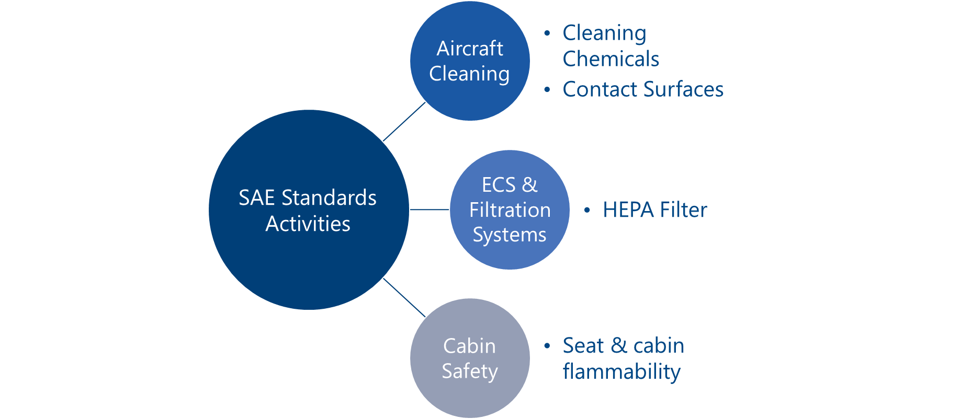
COVID-19 SAE TECHNICAL STANDARDS FOR AIR TRAVEL
SAE International is working with existing technical committees and partnering with external stakeholders to assist with safe air transport through the Covid-19 Crisis.

Slide 3
AIRCRAFT CLEANING – DISINFECTANTS STANDARDS
SAE AMS-J - Aircraft Maintenance Chemicals and Materials Committee. The objective of the Committee is to comply with major airframe manufacturer's basic requirements for aircraft maintenance and chemical materials, such as aircraft cleaners and disinfectants.
Relevant Standards include:
AMS1452C Disinfectant, Aircraft, General Purpose (concentrated liquid)
AMS1453A Disinfectant Cleaner for Aircraft Interior General Purpose Liquid (diluted)
The specifications deal only with the effect of the fluid on the materials of construction used in aircraft.
Requirements in the specifications are that the product will remove normally accumulated soils from the surfaces being cleaned and shall leave those surfaces in a disinfected or sanitized condition without any visible residue. Must meet flammability tests.

Slide 4
ENIVIRONMENTAL CONTROL SYSTEMS AND FILTRATION SYSTEMS STANDARDS
SAE AC-9 - Aircraft Environmental Systems Committee. The committee addresses all facets of aircraft environmental systems–design, maintenance, and in-service experience. It is responsible for furthering the advancement of technology related to the research, design, test and utilization of aircraft environmental systems
AIR4766/1 Air Quality for Commercial Aircraft Cabin Particulate Contaminants
This Aerospace Information Report covers airborne particulate contaminants that may be present in commercial aircraft cabin air during operation. Discussions cover sources of contaminants, methods of control and design recommendations. Air quality, ventilation requirements and standards are also discussed. This document covers design information regarding particulate contaminants in commercial aircraft. This document provides information on Environmental Control System (ECS), particulate contamination (solid and liquid phases), bleed and recirculated air and control methods including ventilation used to design and maintain cabin air environments. Includes HEPA filter performance and efficiency.

Slide 5
ENIVIRONMENTAL CONTROL SYSTEMS AND FILTRATION SYSTEMS STANDARDS (CONT.)
AIR4766/2 Airborne Chemicals in Aircraft Cabins
This SAE Aerospace Information Report provides information on aircraft cabin air quality, including: Airborne contaminant gases, vapors, and aerosols; Identified potential sources; Comfort, health and safety issues; Airborne chemical measurement; Regulations and standards; Operating conditions and equipment that may cause aircraft cabin contamination by airborne chemicals (including Failure Conditions and normal Commercial Practices); Airborne chemical control systems.
It does not deal with airflow requirements.

Slide 6
CABIN SAFETY – SEAT STANDARDS
SAE SEAT COMMITTEE
Information Letter on Cleaning/Disinfecting Aircraft Seats issued in June. It provided a summary of the existing knowledge within the Committee for cleaning and disinfecting seats using certain cleaning/disinfecting products. It was compiled based on seat material manufacturer recommendations, limited testing, and analysis.
The committee is undertaking a research project with the National Institute for Aviation Research (NIAR) in conjunction with the Federal Aviation Administration to examine the effect of the most common agents on seat component strength, flammability, durability and aesthetics. This research is planned to be provided to the industry as it is obtained and the results published in an Aerospace Recommended Practice.

Slide 7
QUESTIONS? Judith.Ritchie@sae.org

