Slide 1
Website Inquiries
Date | Name | Email | Telephone | Message | STC | Disposition | Dispo Date
1-Feb-23 | Juan Ortas Fernández | jortas@ceta.aero | +34 618 861 836 | SA00756DE AML question | SA00756DE | Jon @ Trig | 3-Feb-23
2-Feb-23 | MARIO ALENCAR | mario.alencar@sabaviacao.com.br | 85988393917 | WE WOULD LIKE TO HAVE A QUOTE OF STC ST00835DE . | ST00835DE | Luke @ SEA | 3-Feb-23
2-Feb-23 | Courtney Rosenfeld | courtneyrosenfeld@gigspark.biz | 3217103400 | Hi, The digital revolution has swept the corporate world… |  | Junk | 3-Feb-23
15-Feb-23 | Thomas JULLIEN | thomas.jullien@cavok-aero.com | Telephone: | SAAB 340B S/N : 340B441 ELA |  | TJ @ Peregrine | 17-Feb-23
24-Feb-23 | RAFAEL MESA DUEÑAS | gerenciatecnica@aercaribe.com | +57 3229491756 | LCD replacement for CRT for BOMBARDIER CL600-2A12. |  | DAC | 27-Feb-23
24-Feb-23 | Lance Hernandez | lhernandez@solairus.aero | 5126670944 | G200 FANS1A compliant. | ST00912DE | TJ for Gulfstream | 27-Feb-23

Slide 2
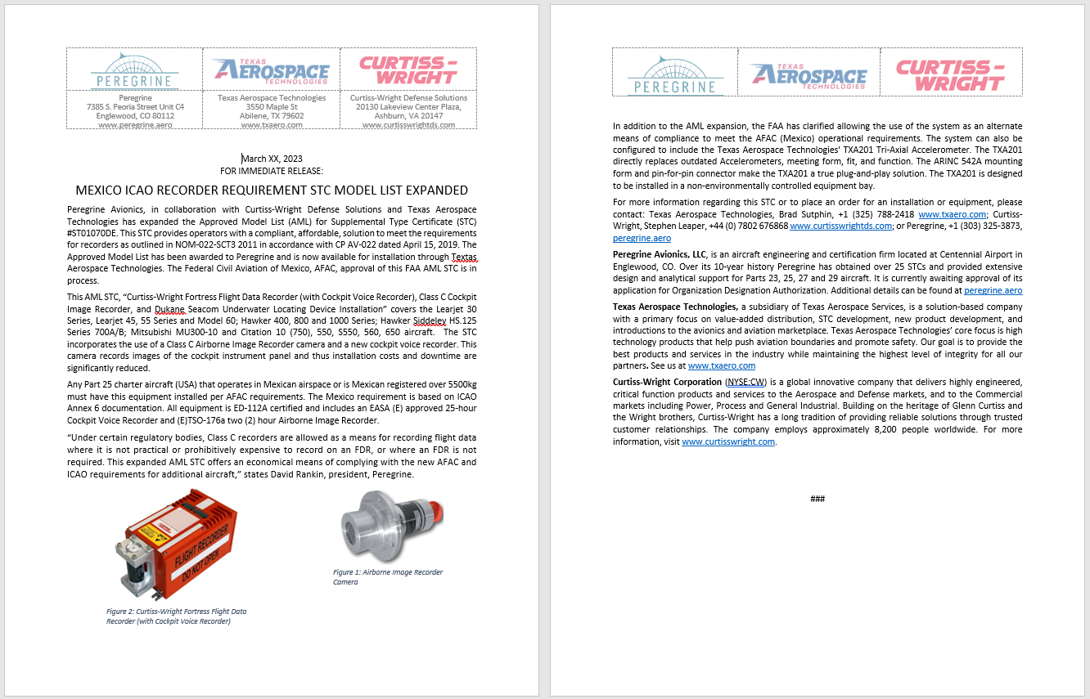
Draft PR

Slide 3
Updates
Added March “Message form Dave”
Added new page for Mexico initiative, awaiting reply for Jessica
Drafted new PR for FDR STC
Attempted contact with Ontic regarding Learjet M60 FQI display

