Slide 1
AviaGlobal recommends a restructuring of the website to merge STC/Product and Project pages, with new material developed around projects in progress, to reinforce the core business message
  Focus should be on enhancing content related to project achievements and blog entries
  Enhance depth of new Peregrine scope content including current in-progress project presentations; focus website on attracting new project clients
  Website could be personalized with addition of a Peregrine Management blog, in addition to the current news feed

Slide 2
STCs and Projects
Peregrine STCs: your engineering leverage
- Experts
- Timely
- Free up your resources
26 STCS, Transport (Part 25), Rotorcraft (part 27 & 29) and Normal (Part 23)
21 different equipment models
100 Makes
2200 Aircraft Models
4 different Air Agencies (FAA, ANAC, AFAC, Transport Canada)
New project focus:
Ajax avionics contracted with Peregrine for an AML STC for a 666-01-01
Seat heater for arctic operations…
Recent projects:
COVID disinfections, ADS-B, TCAS II
STCs

Slide 3

And Projects
Peregrine’s expertise and experience can bring your certification and engineering projects to market with cost-effective speed and efficiency, allowing your company resources to focus on your core business
Explore our STC portfolio
Explore our projects

Slide 4
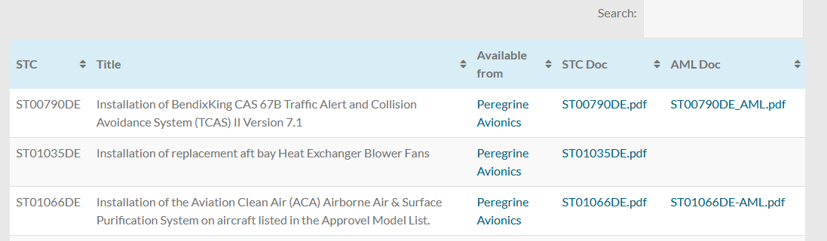
Explore our STC portfolio
26 STCS, Transport (Part 25), Rotorcraft (part 27 & 29) and Normal (Part 23)
21 different equipment models
100 Makes
2200 Aircraft Models
4 different Air Agencies (FAA, ANAC, AFAC, Transport Canada)
Transport Category STCs
Rotorcraft Category STCs
Normal Category STCs

Slide 5
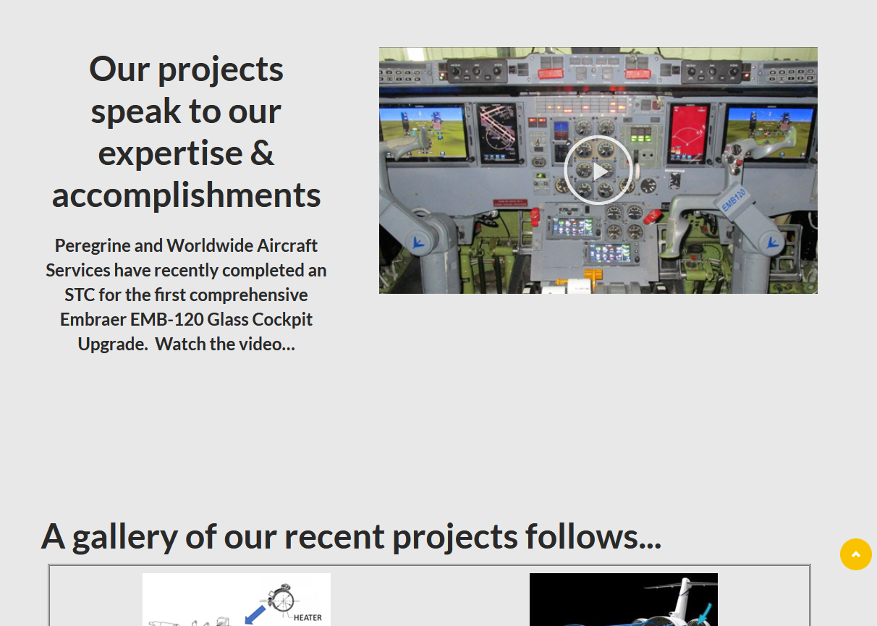
Explore our Projects

Slide 6
Category | project | Client | Peregrine Project | FAA | Phase2
Avionics | FDL-DB STC | FreeFlight Systems | P1206 | ST07720DE-T | Addressing PSCP Comments / FF Software Change
Avionics | Caravan DAA Sensor | XWing / Answer Engineering | P1364 | TBD | Test Plans in Review
Avionics | TX56 VHF Nav-Com Part 23 AML | Trig Avionics | P1449 | TBD | PSCP Development
Avionics | BendixKing Aerocruze Autopilot 100 | Duncan Aviation | P1285 | SA10462CH-A | Amendment Issued / Later Approved Data Submitted
Battery | Dual TB44 Battery | Finnoff Aviation | P1216 | SA07651DE-A | Project Rework for TB40
Battery | True Blue Power TB40 | Mid-Continent Instruments | P1398 | ST06791WI-T | Addressing PSCP Comments
Battery | TB14 Main Ship Battery Part 23 AML | Mid-Continent Instruments | P1450 | TBD | Kickoff
Battery | TS60 Emergency Power Supply | DAC International | P1305 | ST07680DE-T | STC Issued, Foreign Validations
Cockpit Displays | TCAS II IVSI Replacement STC | Southeast Aerospace | P1380 | ST06767WI-T | Awaiting Test Plan Approvals, Installation / Conformity
Cockpit Displays | GI 275 Electrical Standby | Southeast Aerospace | P1379 | ST06793WI-T | Awaiting Test Plan Approvals, Installation / Conformity
Cockpit Displays | EMB-120 Engine Instruments STC | Berry Aviation | P1413 | ST07728DE-T | PSCP Submitted, Design Phase
Cockpit Displays | MD-835 F90 AML Expansion | Mid-Continent Instruments | P1444 | SA06824WI-A | Application Submitted *Stored in Engineering Drive
Lighting | Exterior Lighting Upgrade | Wichita Aerospace | P1391 | ST06776WI-A | Test Report, Compliance Package in Work
Power | Lear 60 AC Power System STC Support | ATSI | P1447 | N/A | Kickoff
Recorder | G200 DFDAU Flight Data Recorder Interface | Curtiss Wright | P1431 | TBD | PSCP in Work
Recorder | TSO Accelerometer for Fortress FDR | Texas Aerospace | P1396 FDR Accelerometer | N/A | Prototyping
Recorder | ST01070DE CVR AML Expansion | SoCal Jets | P1424 | ST07734DE-T / ST01070DE | PSCP Submitted
Systems | Bonanza Cabin Heaters STC | Bascom Hunter | P1457 | TBD | Kickoff
Test Equipment | Thrust Reverser Actuators Test Stand | Talon Air | P1374 | N/A | In Testing / Waiting for actuator parts
 | Component Qualification DO-160 / Flammability Special Project | Gulfstream Aerospace | P1433 | TBD | XX RIP XX

